Slide 1
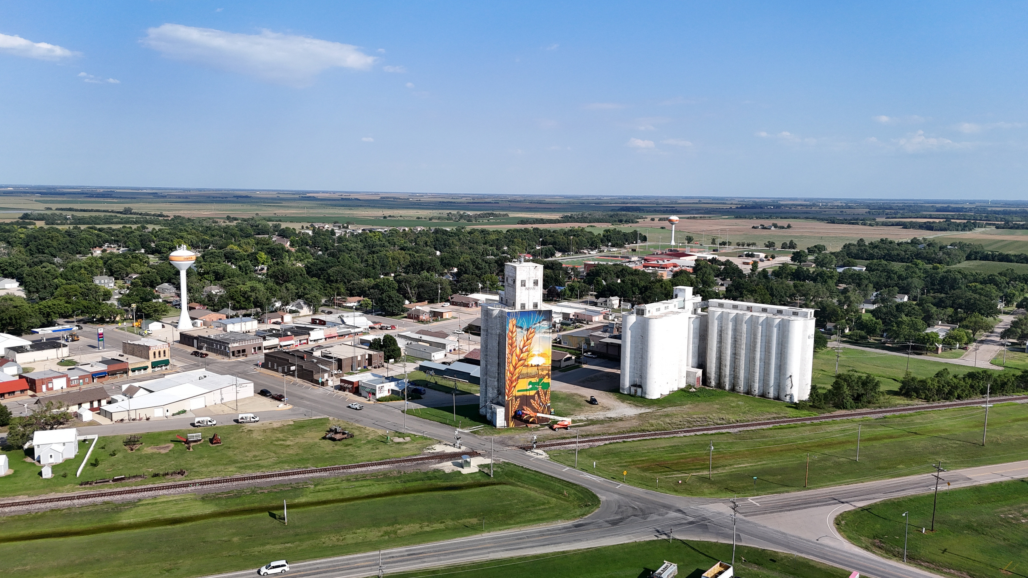




2024
Community Benchmark Report
City of McPherson, KS
Be The Movement! Connect with local changemakers, local community projects, resources & grants, and much more. www.mcphersonfoundation.org.com
Betsy Davis | betsy@mcphersonfoundation.org

Slide 2
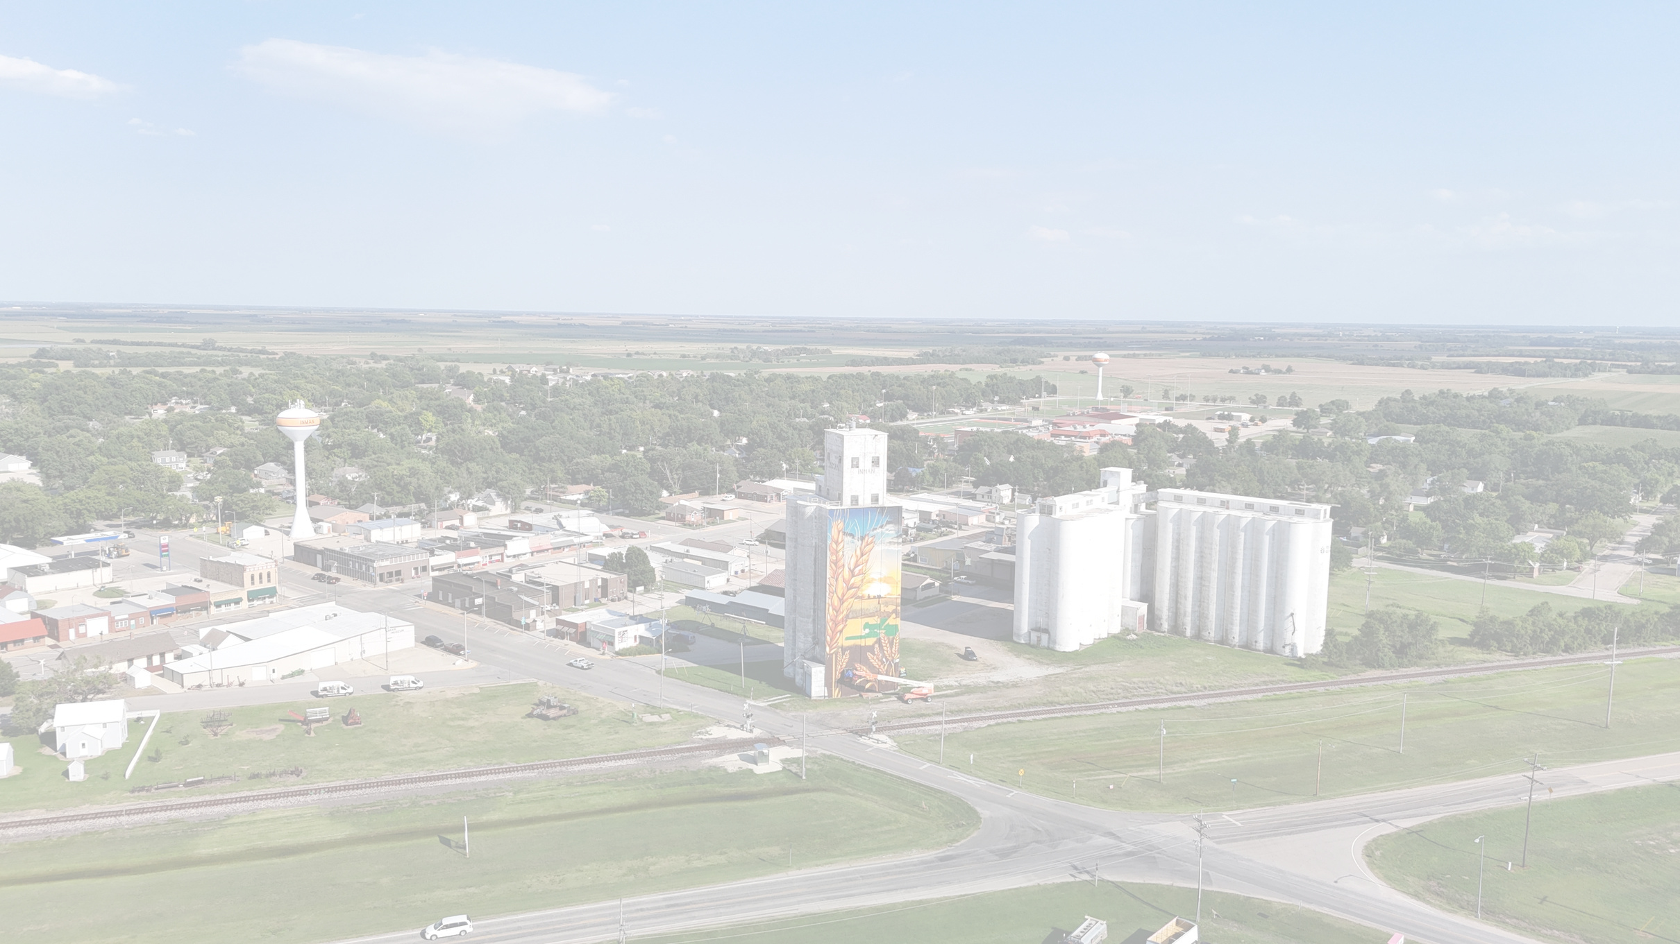









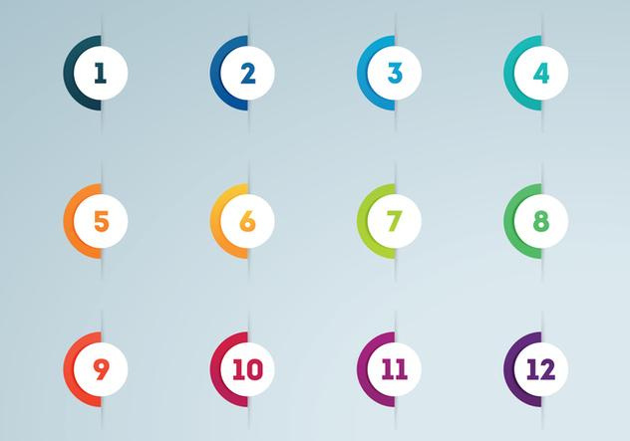



Community Benchmarking Report City of Inman, KS | 2024
The Community Benchmarking report has been commissioned by McPherson County Community Foundation to help local residents gain a better understanding of the most pressing opportunities that the local towns face. The annual reports that are generated will help leaders determine the extent to which the efforts are having an impact on the local residents. The reports are also a way for the the various towns in McPherson County to pursue grants to help further their local efforts.
Local leaders can use this framework to help inspire change.
This report provides the clues on what the fellow residents are craving.
Collaborative Leadership
Committed Citizenship
Community
Economic & Community
Vision & Action
Sustainability

Slide 3
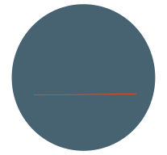

Community Benchmarking Report City of Inman, KS | 2024
Who took the Survey
127
Total Responses
Number of people who expressed an interest in volunteering to better the community
35 of 127 28%
35
(The goal was 125)

Slide 4
Community Benchmarking Report City of Inman, KS | 2024
What Makes Our Community
Special?
Local Leaders

Slide 5

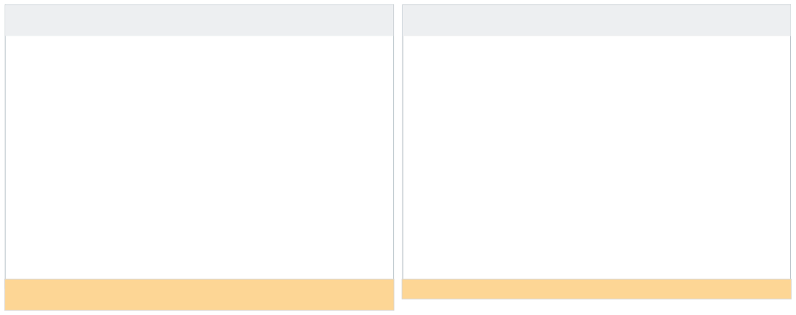
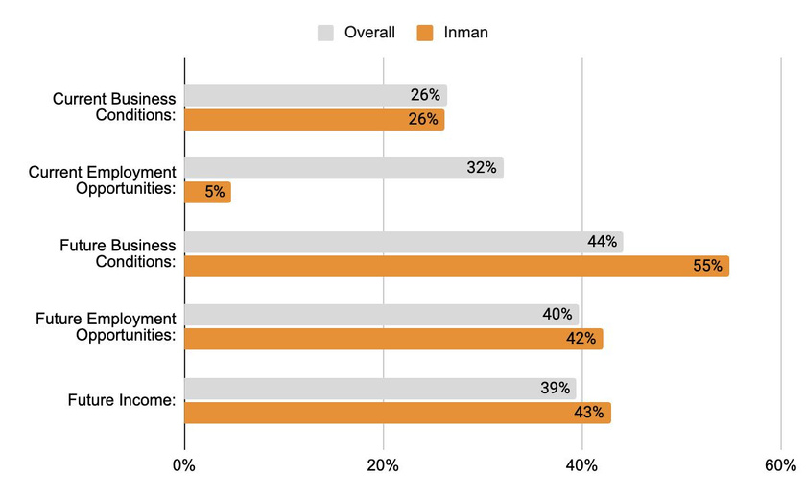
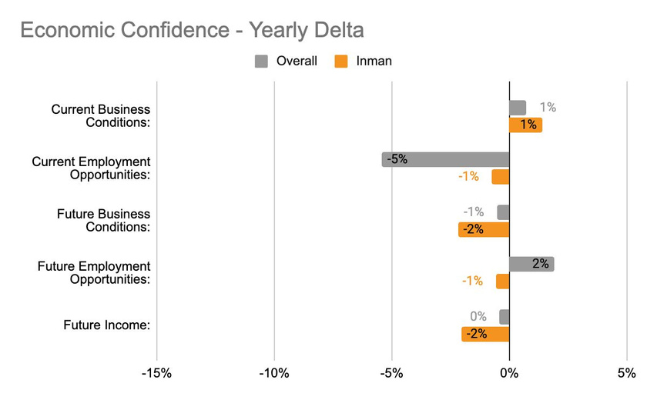
Community Benchmarking Report City of Inman, KS | 2024
Economic Confidence
Our Economic Perceptions
Year Over Year Change (2023 vs 2024)
Although residents don’t see many current employment opportunities, the future is bright
Inman residents didn’t see much shift from last year to this year.

Slide 6
Community Benchmarking Report City of Inman, KS | 2024
Economic Confidence
What is causing the disconnect between business conditions and available job opportunities?
There is mixed perceptions on businesses condition, employment, and income. What development might even these out?

Slide 7
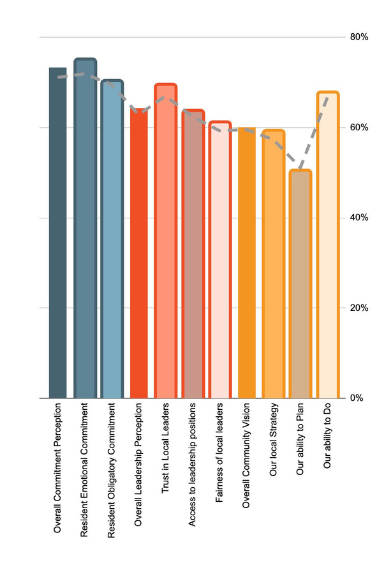
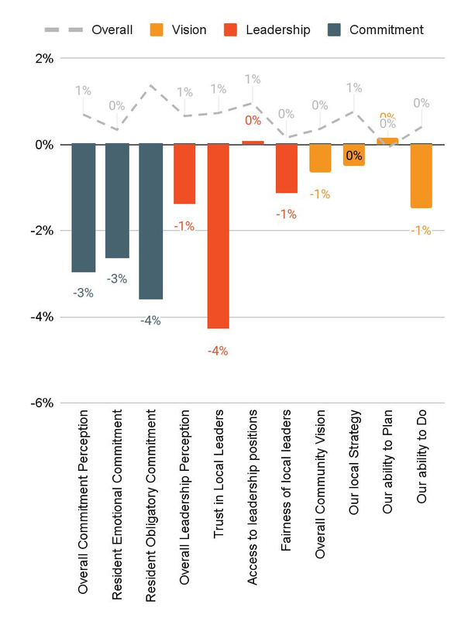
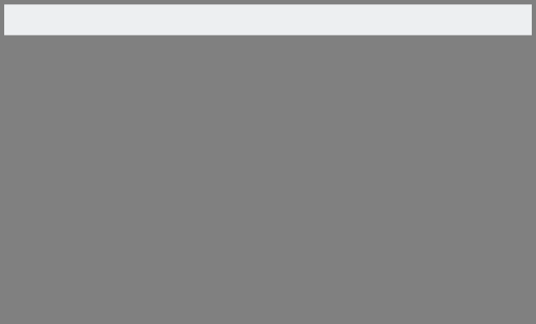
Community Benchmarking Report City of Inman, KS | 2024
Community Engagement
How do our residents view our community?
Year Over Year Change (2023 vs. 2024)

Slide 8
Community Benchmarking Report City of Inman, KS | 2024
Community Engagement
What steps could be taken to work on access and the proception of fairness?
What specific actions can local leaders take to improve communication and transparency with residents?

Slide 9
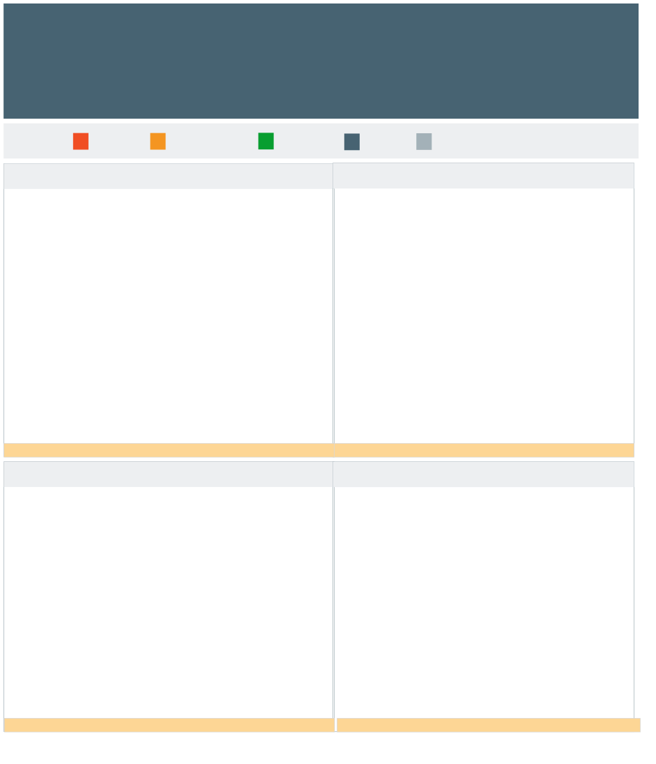
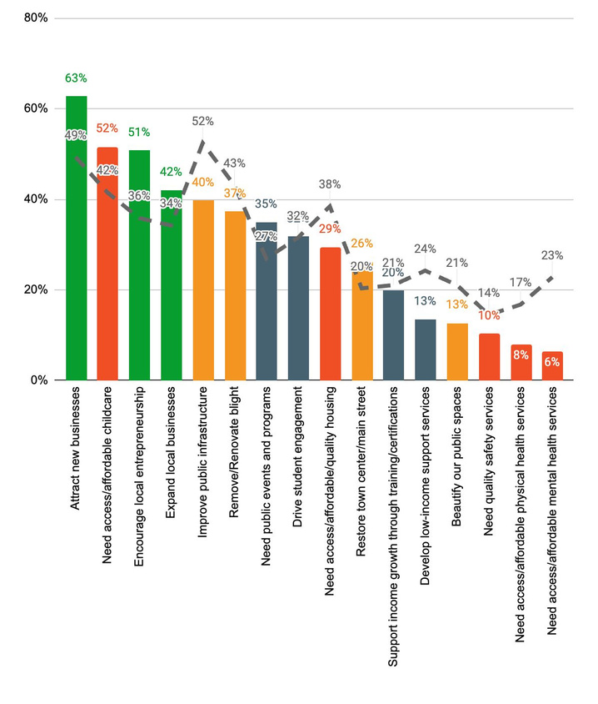
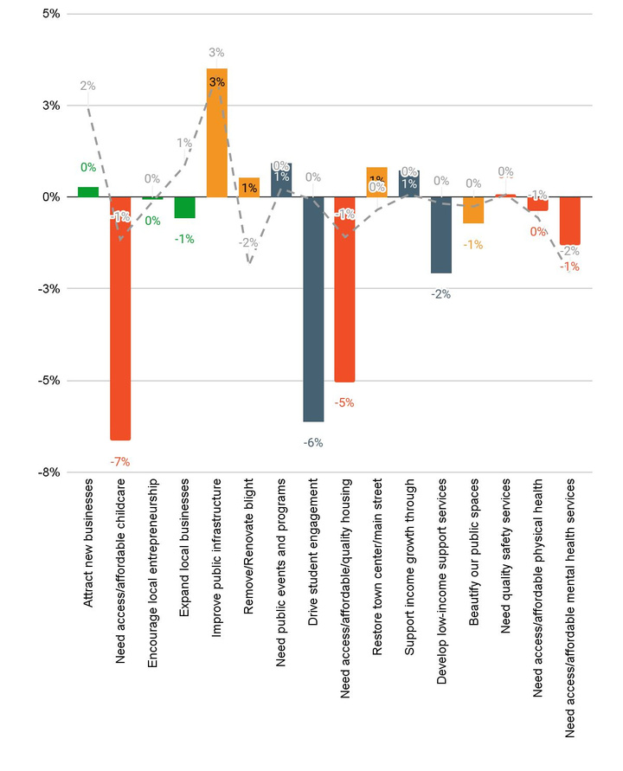

Community Benchmarking Report City of Inman, KS | 2024
Community Priorities
2024 Program Priorities
Priority Shift (2023 vs 2024)
Economic priorities are deﬁnitively #1.
The childcare priority decreased the most but is still in the top 2.

Slide 10
Community Benchmarking Report City of Inman, KS | 2024
Community Priorities
What are some steps that could be taken to address the highlighted issues?
How will McPherson County measure progress on key priorities?

Slide 11
Community Benchmarking Report City of Inman, KS | 2024
Moving forward
County Convenings
Grant opportunities
  Mastermind
  County Grants

Slide 12


Lets Continue the Conversation
  Fill Out the Card on your table
  Sign up for Our Newsletter
  Participate in continuing projects
Betsy Davis | betsy@mcphersonfoundation.org

