Slide 1
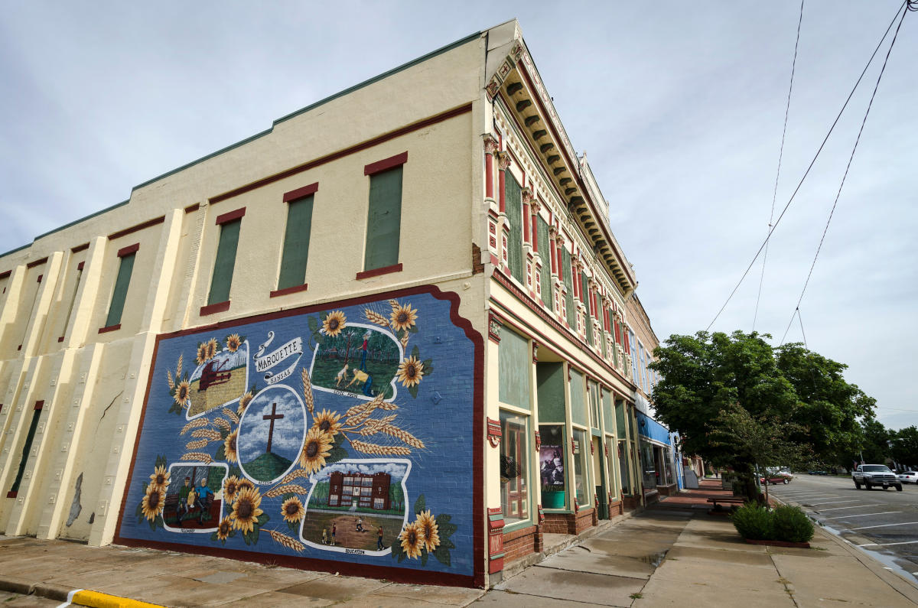



2024
Community Benchmark Report
City of Marquette KS
Be The Movement! Connect with local changemakers, local community projects, resources & grants, and much more. www.mcphersonfoundation.org.com
Betsy Davis | betsy@mcphersonfoundation.org

Slide 2
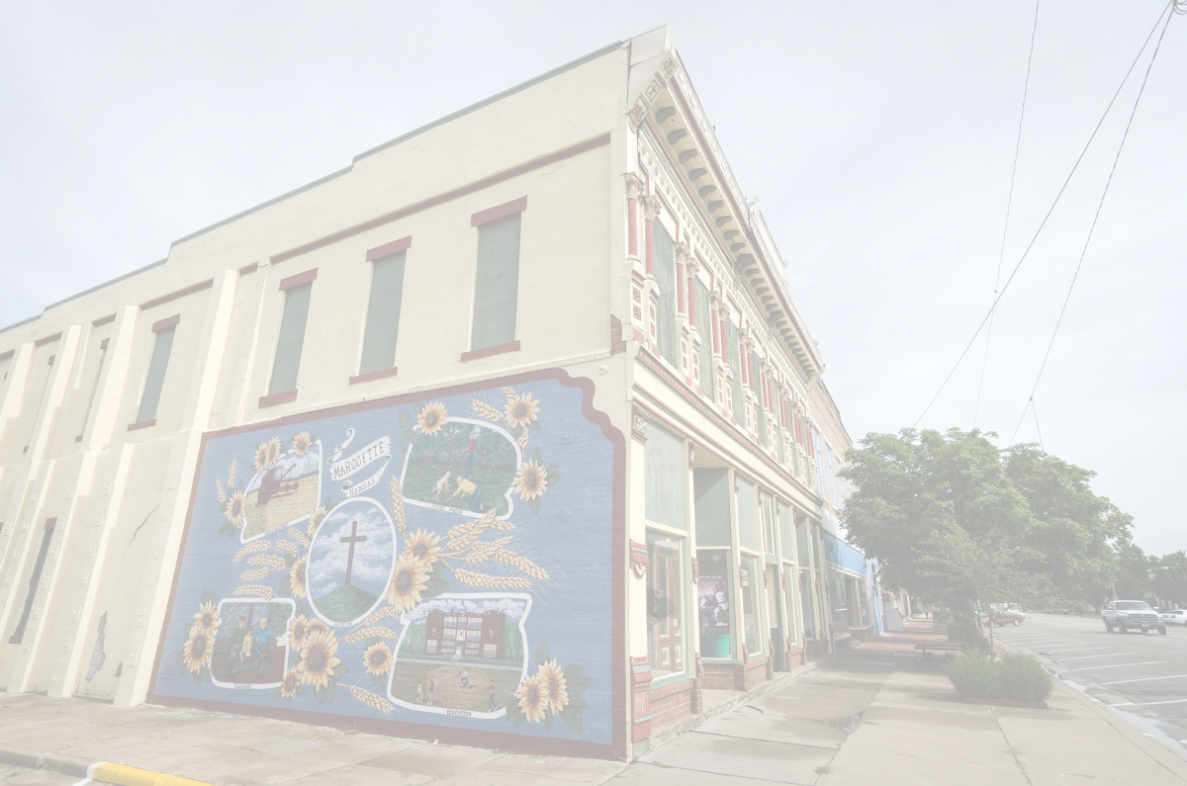









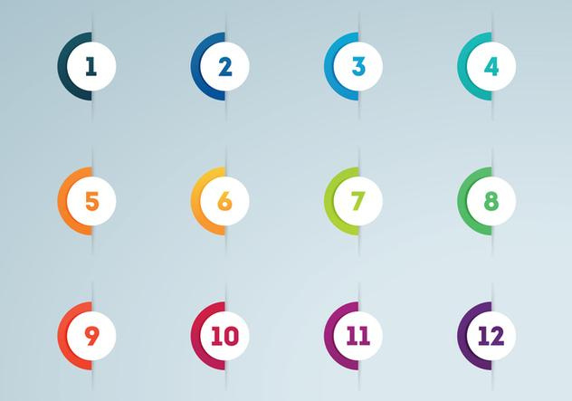



Community Benchmarking Report City of Marquette, KS | 2024
The Community Benchmarking report has been commissioned by McPherson County Community Foundation to help local residents gain a better understanding of the most pressing opportunities that the local towns face. The annual reports that are generated will help leaders determine the extent to which the efforts are having an impact on the local residents. The reports are also a way for the the various towns in McPherson County to pursue grants to help further their local efforts.
Local leaders can use this framework to help inspire change.
This report provides the clues on what the fellow residents are craving.
Collaborative Leadership
Committed Citizenship
Community
Economic & Community
Vision & Action
Sustainability

Slide 3
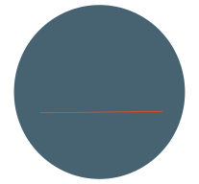

Community Benchmarking Report City of Marquette, KS | 2024
Who took the Survey
65
Total Responses
Number of people who expressed an interest in volunteering to better the community
24 of 65 (37%)
24
(The goal was 70)

Slide 4
Community Benchmarking Report City of Marquette, KS | 2024
What Makes Our Community
Special?
Local Leaders

Slide 5
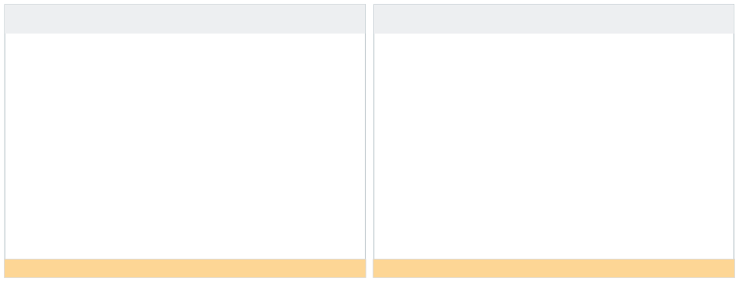

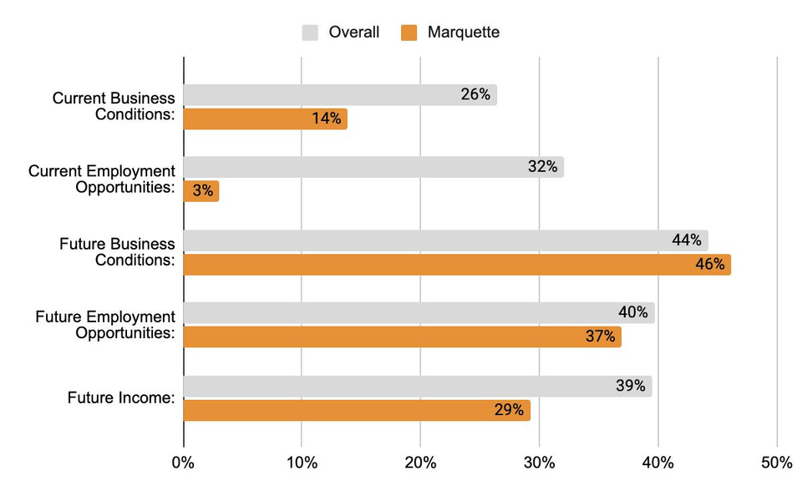
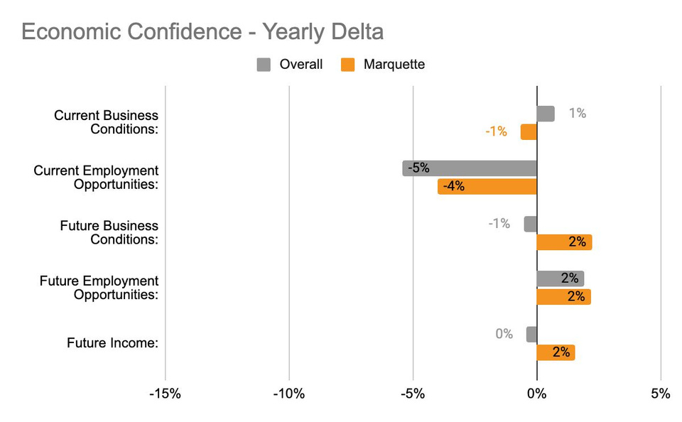


Community Benchmarking Report City of Marquette, KS | 2024
Economic Confidence
Our Economic Perceptions
Year Over Year Change (2023 vs 2024)
Marquette residents have a very positive future outlook.
Future perceptions have even increased from last year also.

Slide 6
Community Benchmarking Report City of Marquette, KS | 2024
Economic Confidence
Current confidence is a bit lower than last year, specifically with employment opportunity. Why do think this is the case?
What could be causing future optimism?

Slide 7
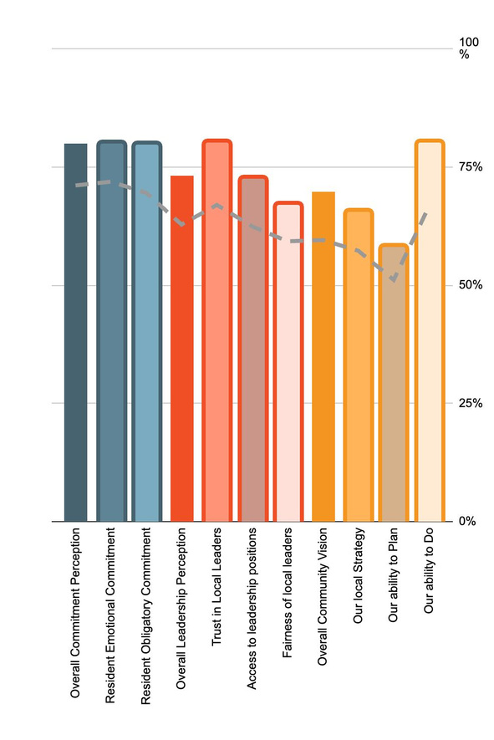
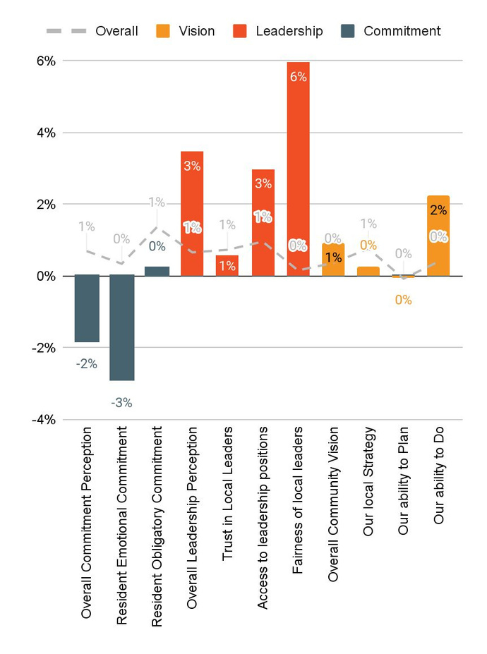
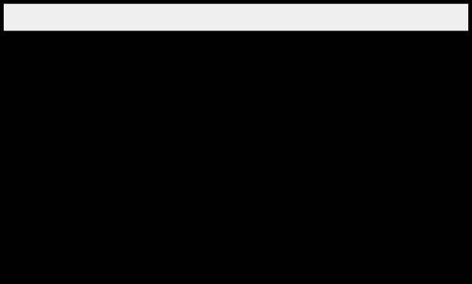

Community Benchmarking Report City of Marquette, KS | 2024
Community Engagement
How do our residents view our community?
Year Over Year Change (2023 vs. 2024)

Slide 8
Community Benchmarking Report City of Marquette, KS | 2024
Community Engagement
What can Marquette Leadership do to foster personal commitment to the community?
There is a considerable difference in planning and doing. What would help raise the planning level?

Slide 9
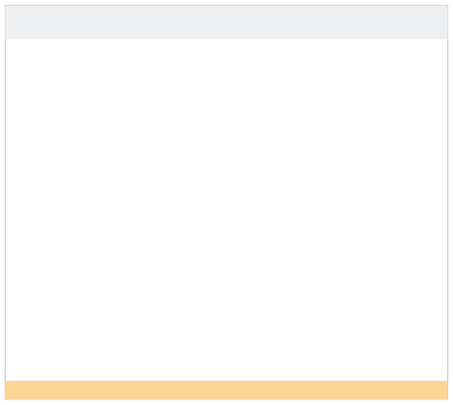

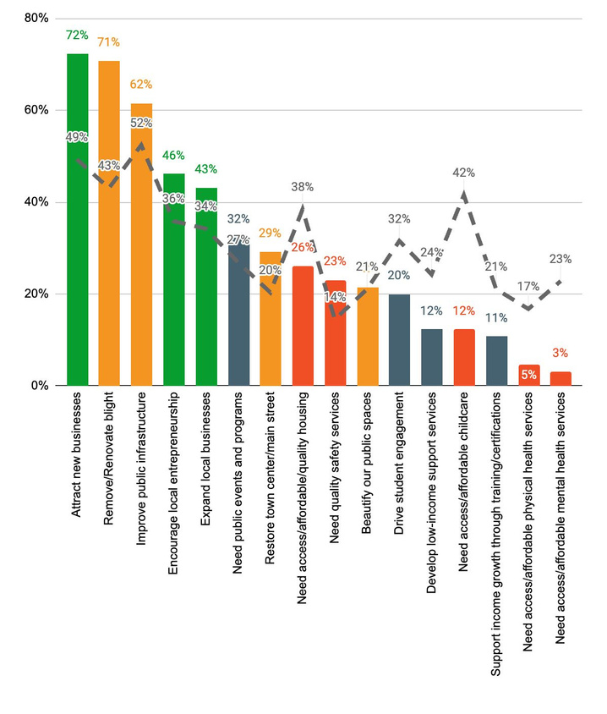
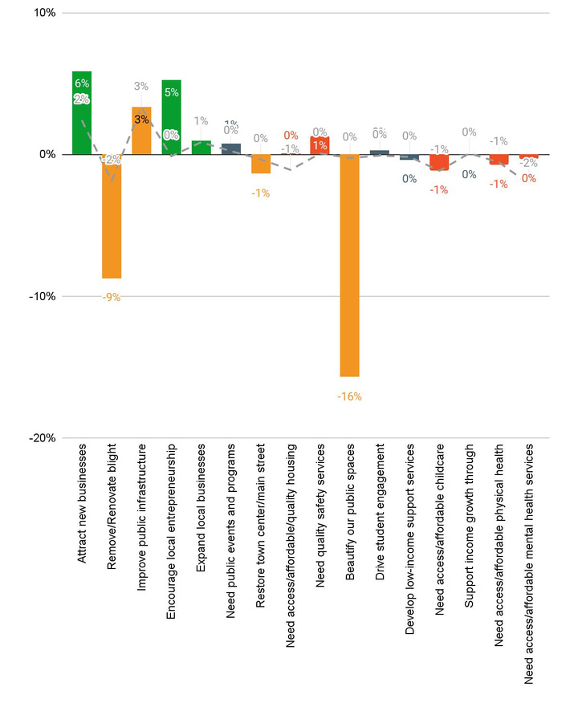

Community Benchmarking Report City of Marquette, KS | 2024
Community Priorities
2024 Program Priorities
Priority Shift (2023 vs 2024)
Economics and placemaking are the top two.
Has there been a priority on beautifying public spaces lately?

Slide 10
Community Benchmarking Report City of Marquette, KS | 2024
Community Priorities
What are some steps that could be taken to address the highlighted issues?
How will Marquette measure progress on key priorities?

Slide 11
Community Benchmarking Report City of Marquette, KS | 2024
Moving forward
Community Priorities shifts
Grant opportunities
  Mastermind
  County Grants
Priority focused conversations

Slide 12


Lets Continue the Conversation
  Fill Out the Card on your table
  Sign up for Our Newsletter
  Participate in continuing projects
Betsy Davis | betsy@mcphersonfoundation.org

