Slide 1
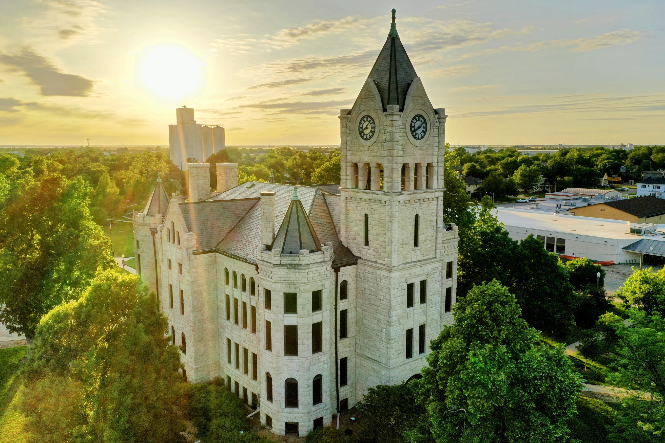





2024
Community Benchmark Report
City of McPherson, KS
Be The Movement! Connect with local changemakers, local community projects, resources & grants, and much more. www.mcphersonfoundation.org.com
Betsy Davis | betsy@mcphersonfoundation.org

Slide 2









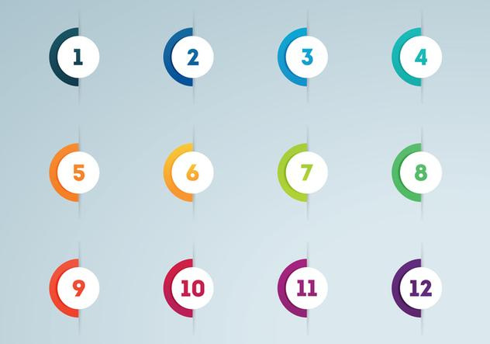



Community Benchmarking Report City of McPherson, KS | 2024
The Community Benchmarking report has been commissioned by McPherson County Community Foundation to help local residents gain a better understanding of the most pressing opportunities that the local towns face. The annual reports that are generated will help leaders determine the extent to which the efforts are having an impact on the local residents. The reports are also a way for the the various towns in McPherson County to pursue grants to help further their local efforts.
Local leaders can use this framework to help inspire change.
This report provides the clues on what the fellow residents are craving.
Collaborative Leadership
Committed Citizenship
Community
Economic & Community
Vision & Action
Sustainability

Slide 3
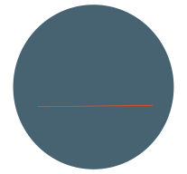

Community Benchmarking Report City of McPherson, KS | 2024
Who took the Survey
370
Total Responses
Number of people who expressed an interest in volunteering to better the community
133 of 370 (36%)
133
(The goal was 300)

Slide 4
Community Benchmarking Report City of McPherson, KS | 2024
What Makes Our Community
Special?
Local Leaders

Slide 5
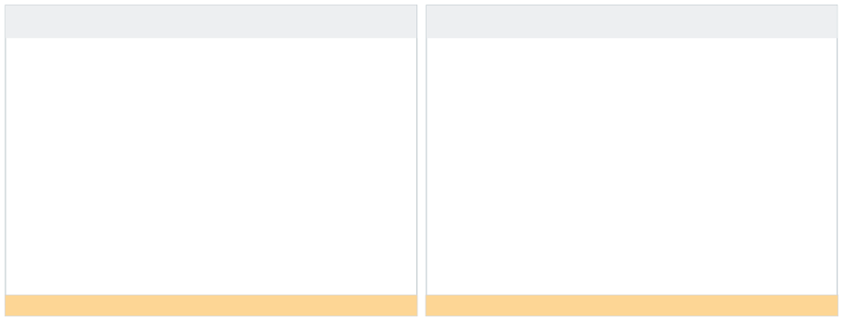
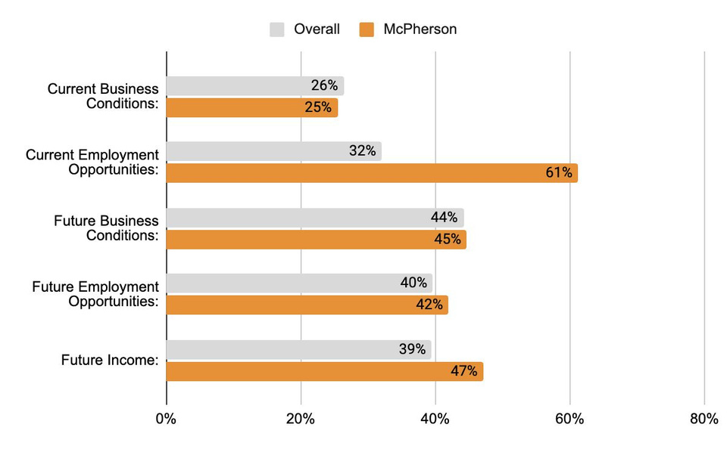

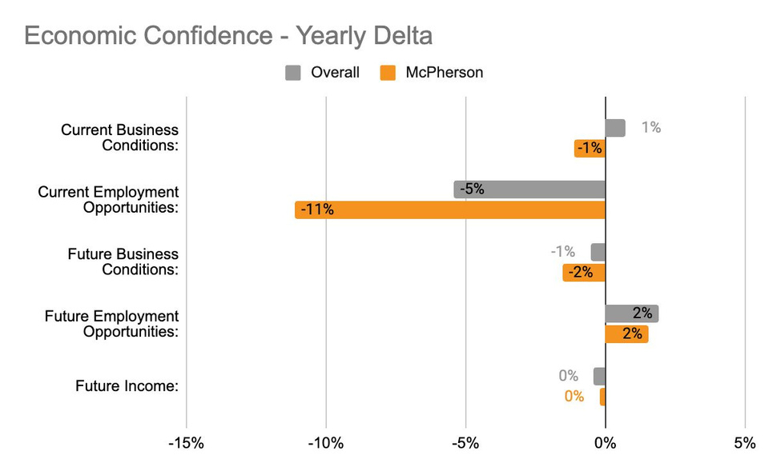


Community Benchmarking Report City of McPherson, KS | 2024
Economic Confidence
Our Economic Perceptions
Year Over Year Change (2023 vs 2024)
Employment opportunities need to be a focus for a shift this big.
Although current employment opportunities are high, the shift went down from last year.

Slide 6
Community Benchmarking Report City of McPherson, KS | 2024
Economic Confidence
While still high confidence in employment opportunities took a large hit from last year. What could be done to address this negative shift?
What could be squelching future optimism?

Slide 7
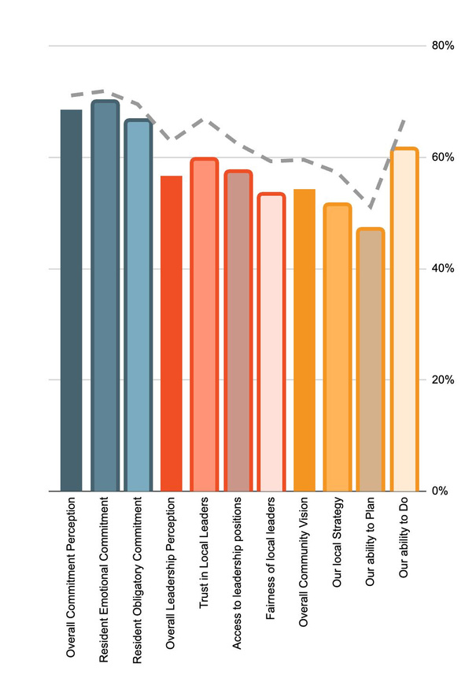
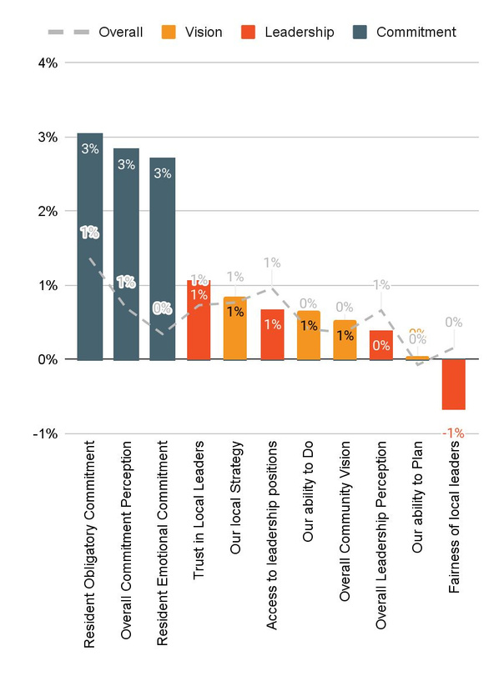
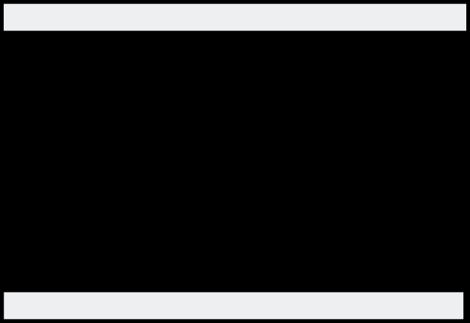

Community Benchmarking Report City of McPherson, KS | 2024
Community Engagement
How do our residents view our community?
Year Over Year Change (2023 vs. 2024)

Slide 8
Community Benchmarking Report City of McPherson, KS | 2024
Community Engagement
What specific initiatives could enhance residents’ sense of belonging and loyality?
How can we better articulate long term plans and make the planning process more transparent?

Slide 9
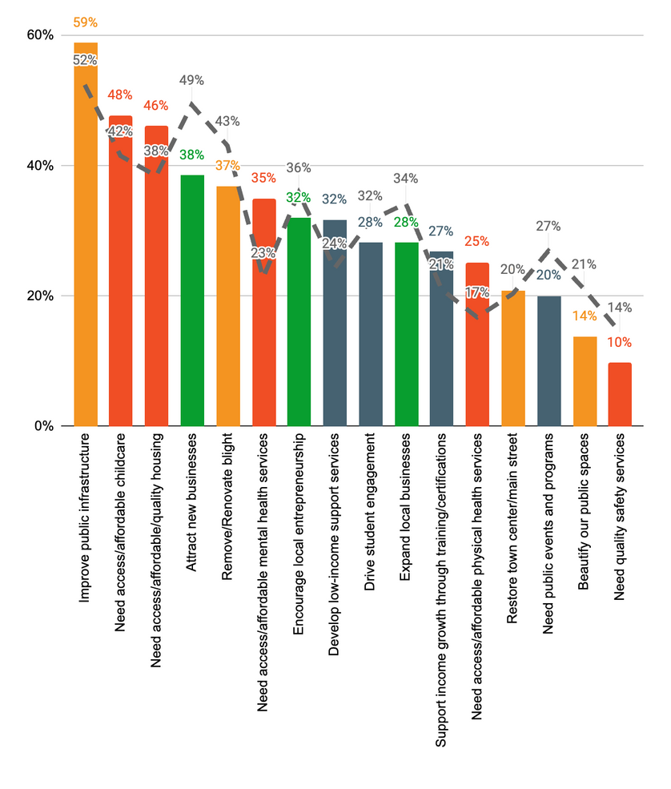
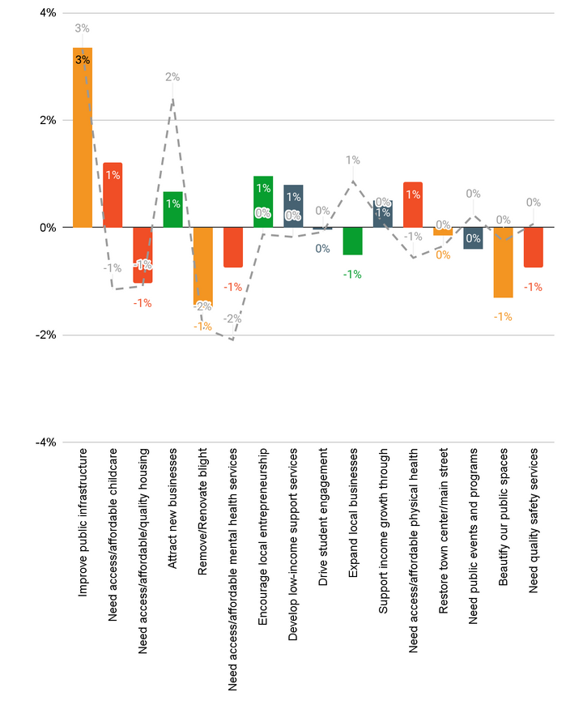
Community Benchmarking Report City of McPherson, KS | 2024
Community Priorities
2024 Program Priorities
Priority Shift (2023 vs 2024)
Priorities seem to be well-rounded.
Public infrastructure jumped to the top of the list and the biggest shift

Slide 10
Community Benchmarking Report City of McPherson, KS | 2024
Community Priorities
What are some steps that could be taken to address the highlighted issues?
How will McPherson measure progress on key priorities?

Slide 11
Community Benchmarking Report City of McPherson, KS | 2024
Moving forward
Community Priorities Shift
Grant opportunities
  Mastermind
  County Grants
County Convenings

Slide 12


Lets Continue the Conversation
  Fill Out the Card on your table
  Sign up for Our Newsletter
  Participate in continuing projects
Betsy Davis | betsy@mcphersonfoundation.org

