Slide 1
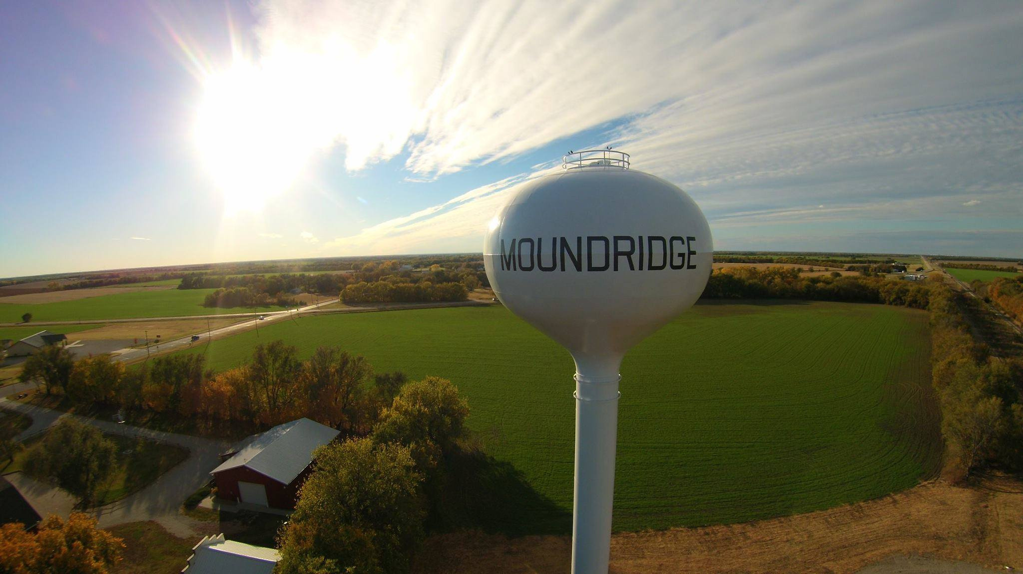





2024
Community Benchmark Report
City of Moundridge, KS
Be The Movement! Connect with local changemakers, local community projects, resources & grants, and much more. www.mcphersonfoundation.org.com
Betsy Davis | betsy@mcphersonfoundation.org

Slide 2
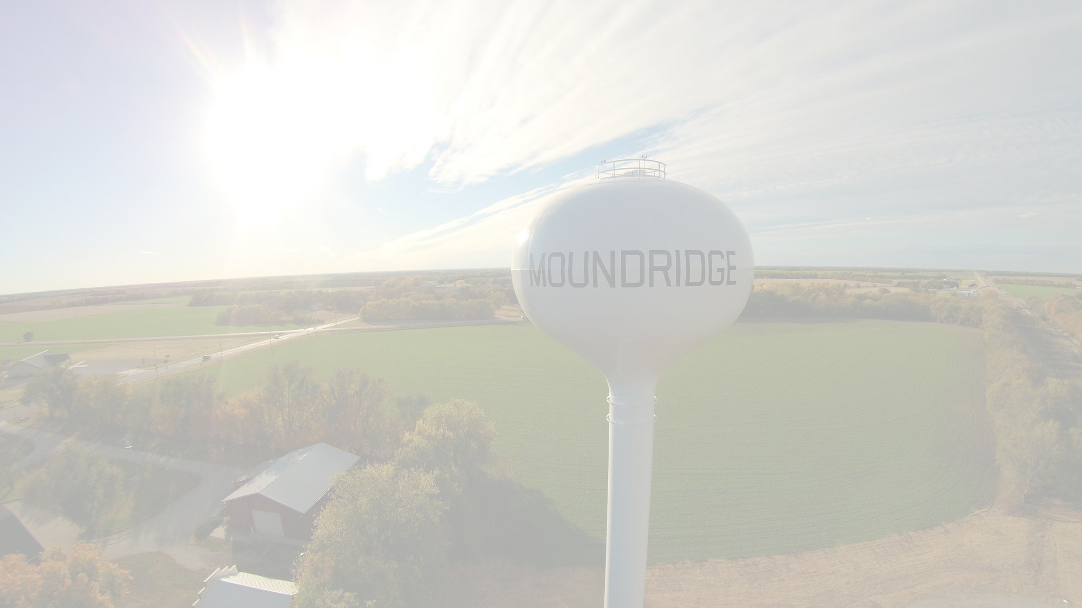









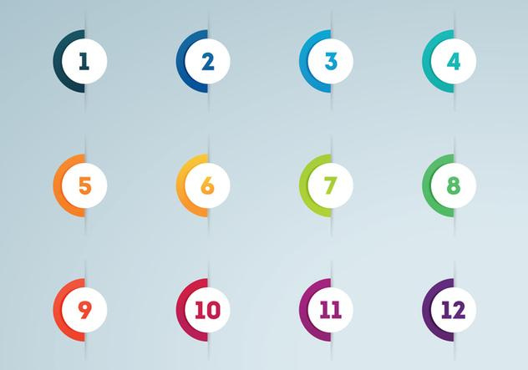



Community Benchmarking Report City of Moundridge, KS | 2024
The Community Benchmarking report has been commissioned by McPherson County Community Foundation to help local residents gain a better understanding of the most pressing opportunities that the local towns face. The annual reports that are generated will help leaders determine the extent to which the efforts are having an impact on the local residents. The reports are also a way for the the various towns in McPherson County to pursue grants to help further their local efforts.
Local leaders can use this framework to help inspire change.
This report provides the clues on what the fellow residents are craving.
Collaborative Leadership
Committed Citizenship
Community
Economic & Community
Vision & Action
Sustainability

Slide 3
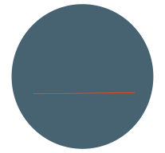

Community Benchmarking Report City of Moundridge, KS | 2024
Who took the Survey
133
Total Responses
42
Number of people who expressed an interest in volunteering to better the community
42 of 125 (34%)
(The goal was 125)

Slide 4
Community Benchmarking Report City of Moundridge, KS | 2024
What Makes Our Community
Special?
Local Leaders

Slide 5
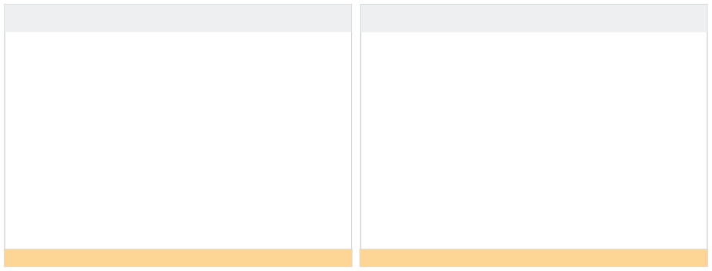

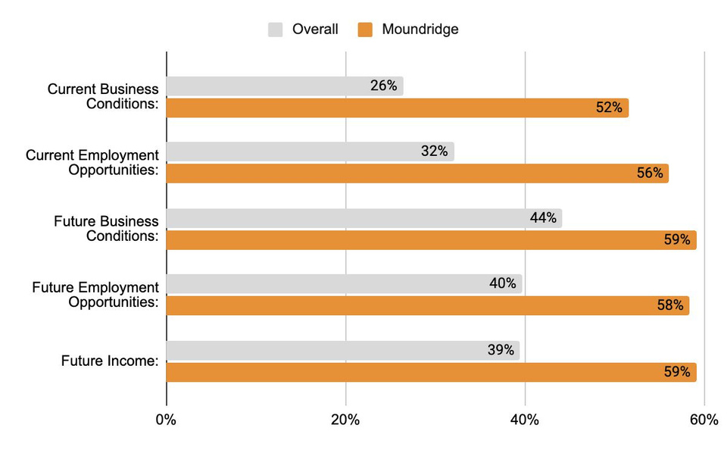
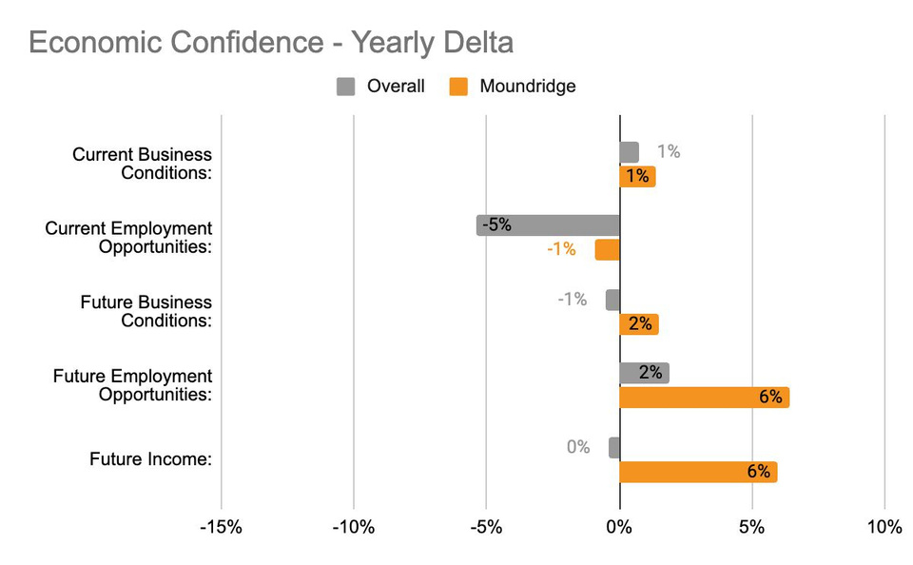


Community Benchmarking Report City of Moundridge, KS | 2024
Economic Confidence
Our Economic Perceptions
Year Over Year Change (2023 vs 2024)
Everything is looking up in Moundridge!!! Great job!
Current numbers look good, future numbers look good and even increased.

Slide 6
Community Benchmarking Report City of Moundridge, KS | 2024
Economic Confidence
Economic confidence looks great and even better in the future. What drives this optimism?

Slide 7
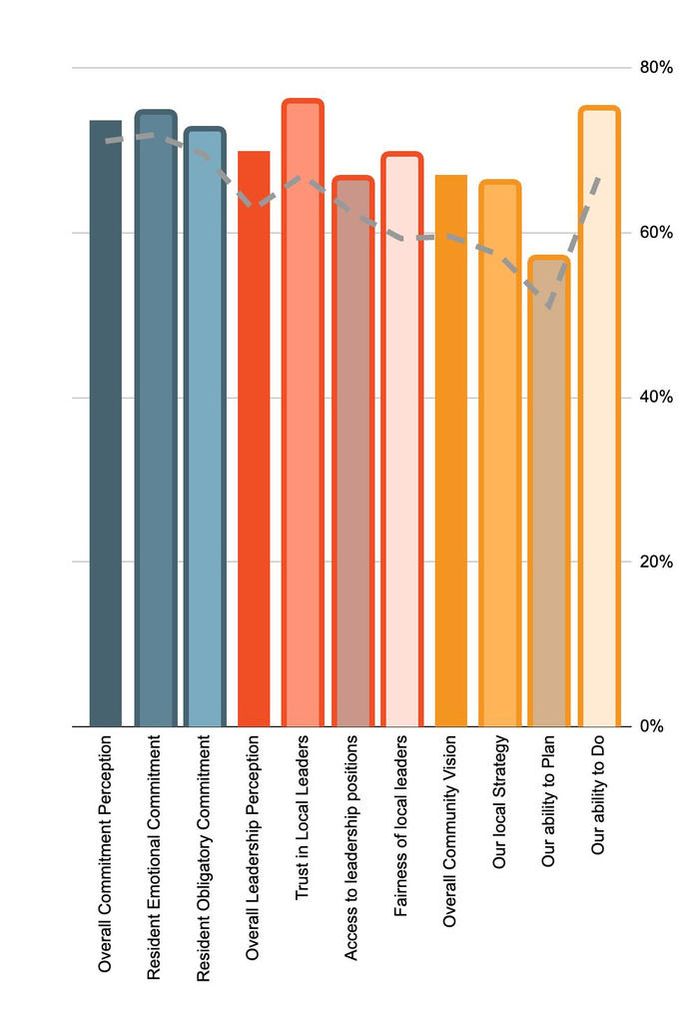
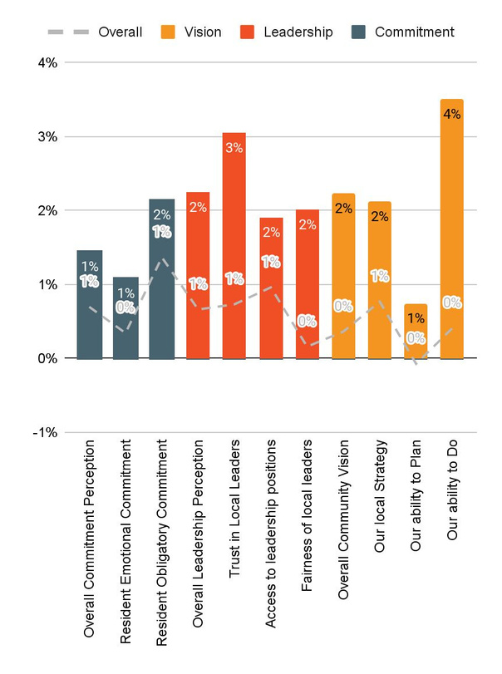
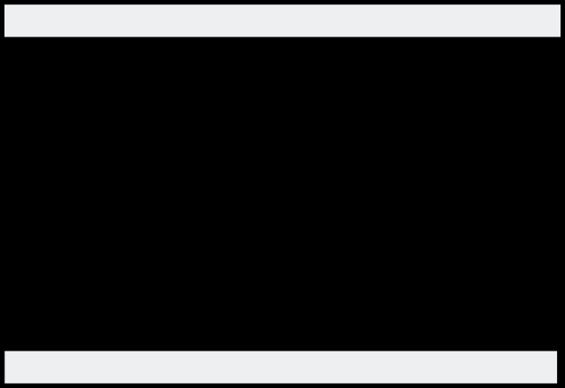

Community Benchmarking Report City of Moundridge, KS | 2024
Community Engagement
Year Over Year Change (2023 vs. 2024)
How do our residents view our community?
Year Over Year Change (2023 vs. 2024)

Slide 8
Community Benchmarking Report City of Moundridge, KS | 2024
Community Engagement
What has leadership and the community done over the past year to develop community engagement?
Vision lags behind the other categories. What can leaders do to engage the community in the planning process?

Slide 9
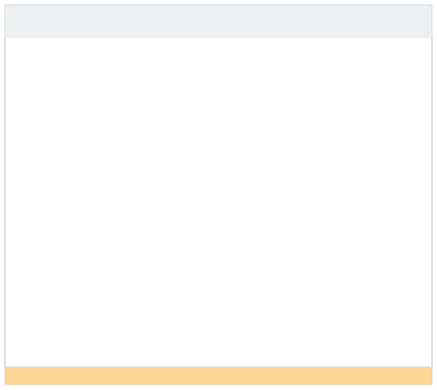

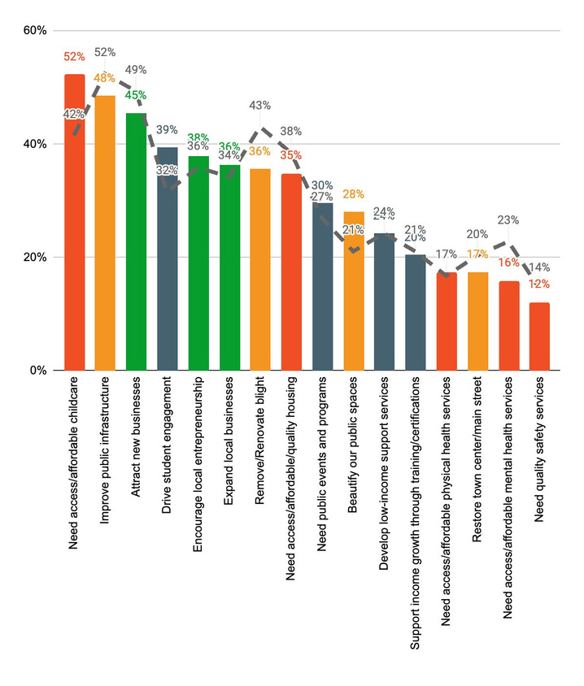
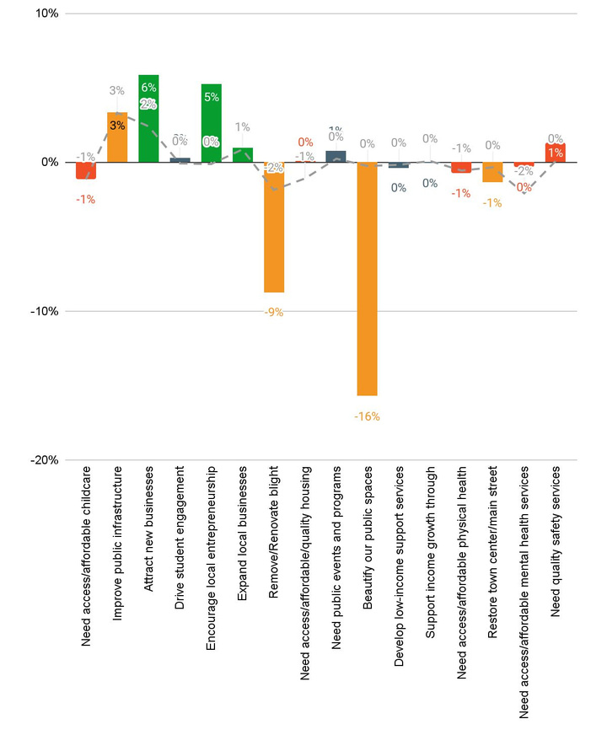

Community Benchmarking Report City of Moundridge, KS | 2024
Community Priorities
2024 Program Priorities
Priority Shift (2023 vs 2024)
Childcare took the lead, but economic programs were all in the top 6.
Beautifying public spaces made the biggest shift downward.

Slide 10
Community Benchmarking Report City of Moundridge, KS | 2024
Community Priorities
What are some steps that could be taken to address the highlighted issues?
How will Moundridge measure progress on key priorities?

Slide 11
Community Benchmarking Report City of Moundridge, KS | 2024
Moving forward
Community Priorities Shift?
Grant opportunities
  Mastermind
  County Grants
Priority focused conversations

Slide 12

Lets Continue the Conversation
  Fill Out the Card on your table
  Sign up for Our Newsletter
  Participate in continuing projects
Betsy Davis | betsy@mcphersonfoundation.org

