Slide 1
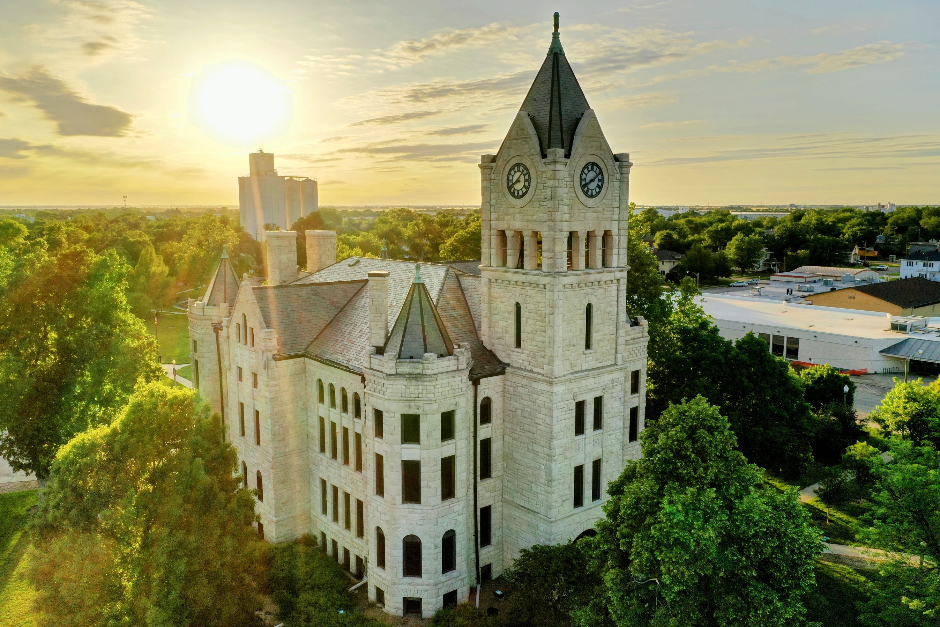




2024
Community
Benchmark Report
Community of McPherson
& Surrounding Areas
Be The Movement!
Connect with local changemakers, local community projects, resources & grants, and much more.
www.mcphersonfoundation.org
Betsy Davis | betsy@mcphersonfoundation.org

Slide 2






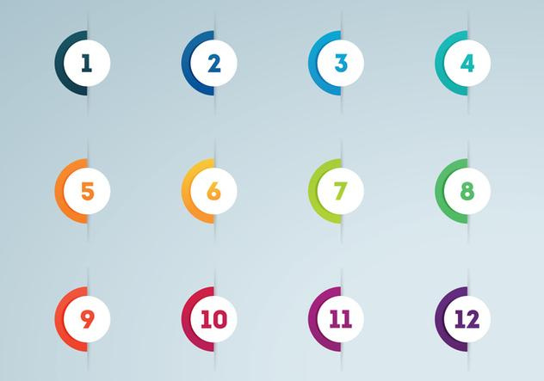



Community Benchmarking Report
McPherson & Surrounding Areas | 2024
The Community Benchmarking report has been commissioned by McPherson County Community Foundation to help local residents gain a better understanding of the most pressing opportunities that the local towns face. The annual reports that are generated will help leaders determine the extent to which the efforts are having an impact on the local residents. The reports are also a way for the the various towns in McPherson County to pursue grants to help further their local efforts.
Local leaders can use this framework to help inspire change.
This report provides the clues on what the fellow residents are craving.
Collaborative Leadership
Committed Citizenship
Community
Economic & Community
Vision & Action
Sustainability

Slide 3
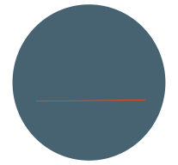

Community Benchmarking Report
McPherson & Surrounding Areas | 2024
Who took the Survey
973
Total Responses
Number of people who expressed an interest in volunteering to better the community
318 of 973 (33%)
318
(The goal was 885)

Slide 4
Community Benchmarking Report
McPherson & Surrounding Areas | 2024
What Makes Our Community
Special?
Local Leaders

Slide 5
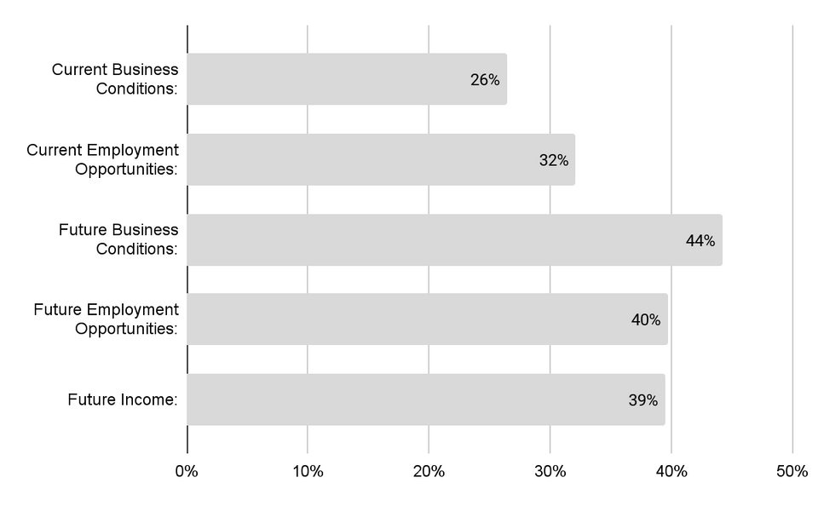
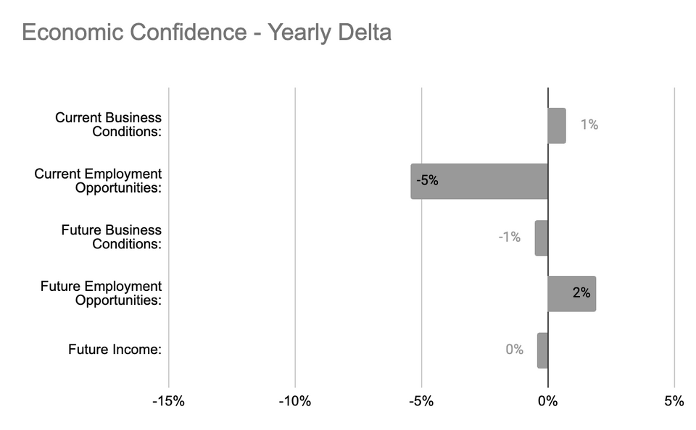

Community Benchmarking Report
McPherson & Surrounding Areas | 2024
Economic Confidence
Our Economic Perceptions
Year Over Year Change (2023 vs 2024)

Slide 6
Community Benchmarking Report
McPherson & Surrounding Areas | 2024
Economic Confidence
While still high confidence in employment opportunities took a large hit from last year. What could be done to address this negative shift?
What could be squelching future optimism?

Slide 7
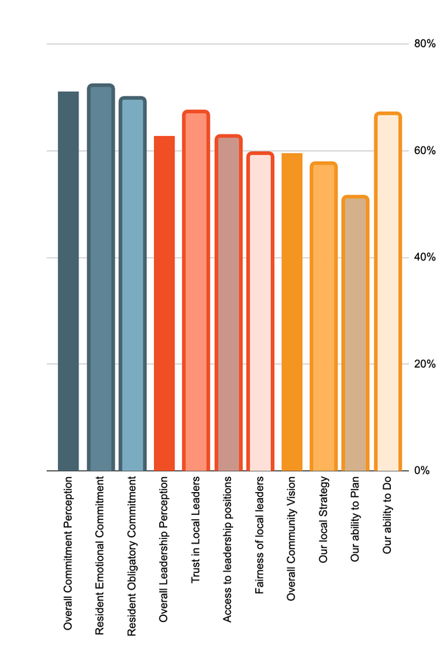
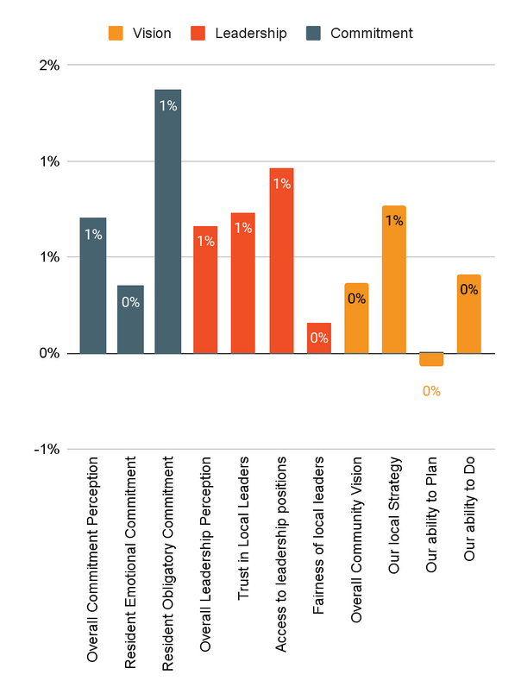
Community Benchmarking Report
McPherson & Surrounding Areas | 2024
Community Engagement
How do our residents view our community?
Year Over Year Change (2023 vs. 2024)

Slide 8
Community Benchmarking Report
McPherson & Surrounding Areas | 2024
Community Engagement
What steps could be taken to work on access and the proception of fairness?
What specific actions can local leaders take to improve communication and transparency with residents?

Slide 9
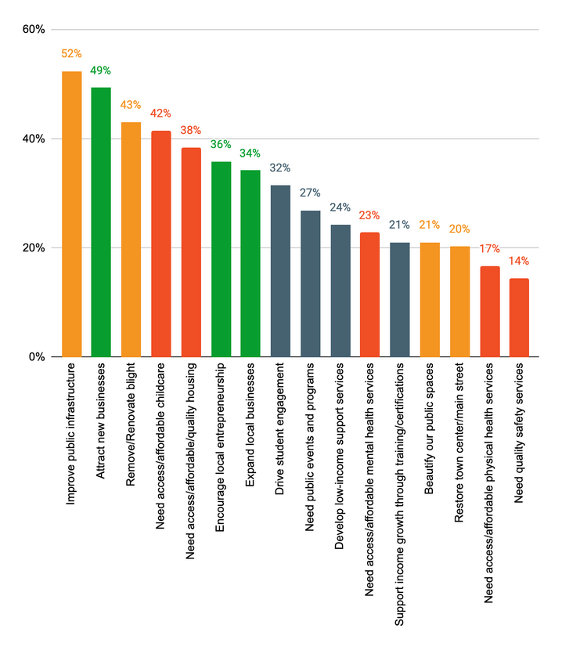
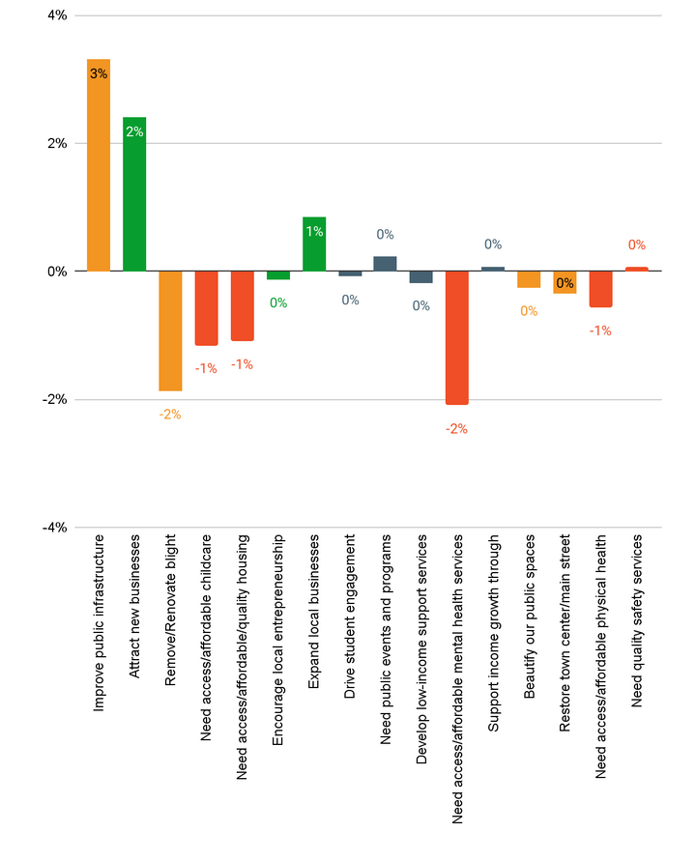
Community Benchmarking Report
McPherson & Surrounding Areas | 2024
Community Priorities
2024 Program Priorities
Priority Shift (2023 vs 2024)
Each category is well diversified in priority.
Public infrastructure remains a top priority year over year

Slide 10
Community Benchmarking Report
McPherson & Surrounding Areas | 2024
Community Priorities
What are some steps that could be taken to address the highlighted issues?
How will McPherson County measure progress on key priorities?

Slide 11
Community Benchmarking Report
McPherson & Surrounding Areas | 2024
15 Minute Break

Slide 12
Community Benchmarking Report
McPherson & Surrounding Areas | 2024
Priority Breakouts Sessions (2)
Child Care- McPherson Suite
Community Health- Back of Room
Economic Development- Global Refiner Suite
Leadership- Front of Room
Placemaking- Middle Room
15 Minute Break

Slide 13
Community Benchmarking Report
McPherson & Surrounding Areas | 2024
Moving forward
County Convenings
Grant opportunities
  Mastermind
  County Grants

Slide 14




Lets Continue the Conversation
  Fill Out the Card on your table
  Sign up for Our Newsletter
  Participate in continuing projects
Betsy Davis | betsy@mcphersonfoundation.org

