Slide 1
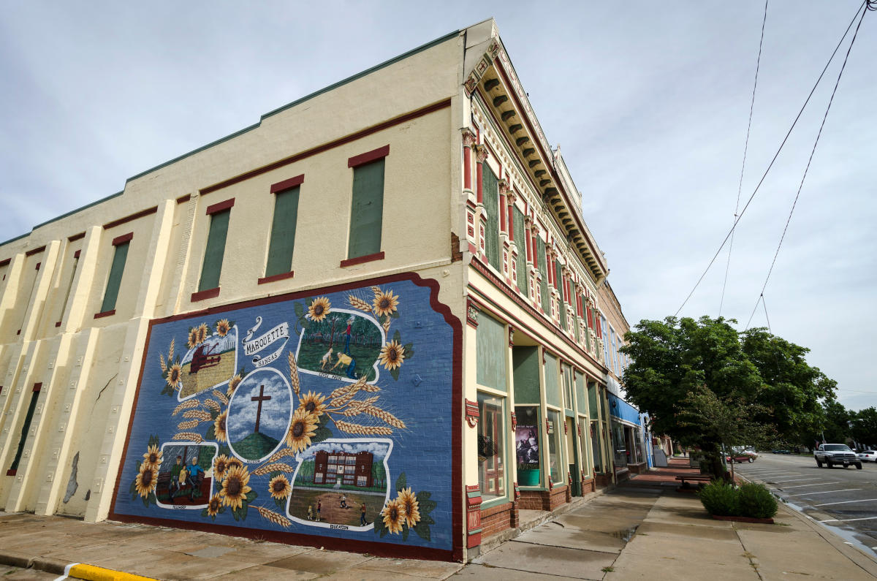



2025
Community Benchmark Report
City of Marquette KS
Be The Movement! Connect with local changemakers, local community projects, resources & grants, and much more. www.mcphersonfoundation.org.com
Betsy Davis | betsy@mcphersonfoundation.org

Slide 2
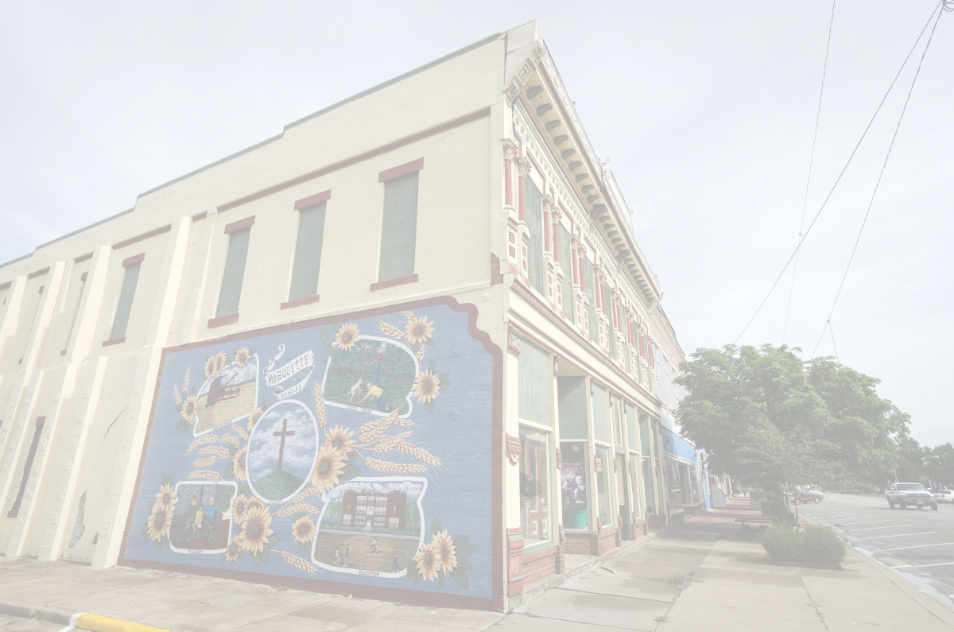









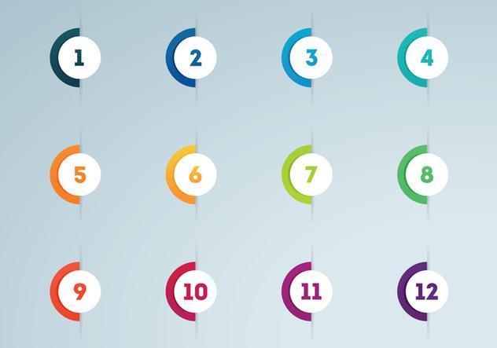



Community Benchmarking Report City of Marquette, KS | 2025
The Community Benchmarking report has been commissioned by McPherson County Community Foundation to help local residents gain a better understanding of the most pressing opportunities that the local towns face. The annual reports that are generated will help leaders determine the extent to which the efforts are having an impact on the local residents. The reports are also a way for the the various towns in McPherson County to pursue grants to help further their local efforts.
Local leaders can use this framework to help inspire change.
This report provides the clues on what the fellow residents are craving.
Collaborative Leadership
Committed Citizenship
Community
Economic & Community
Vision & Action
Sustainability

Slide 3
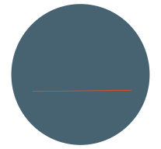

Community Benchmarking Report City of Marquette, KS | 2025
Who took the Survey
31
Total Responses
Number of people who expressed an interest in volunteering to better the community
11 of 31 (35%)
11
(The goal was 70)

Slide 4
Community Benchmarking Report City of Marquette, KS | 2025
What Makes Our Community Special?
Local Leaders

Slide 5
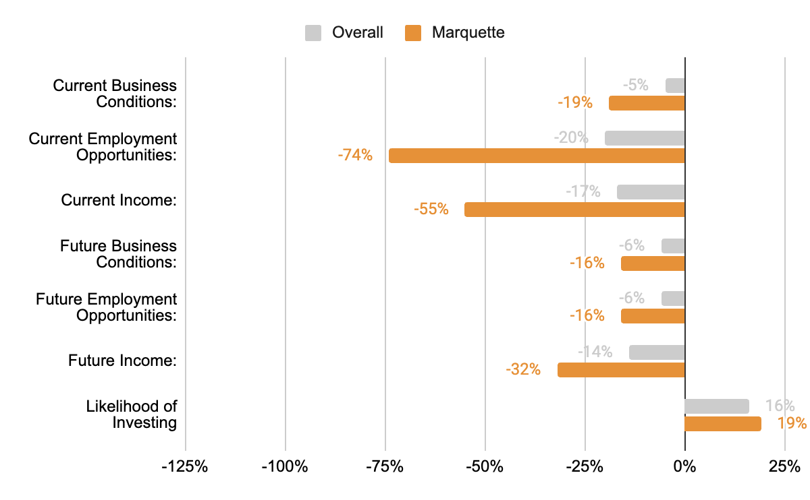
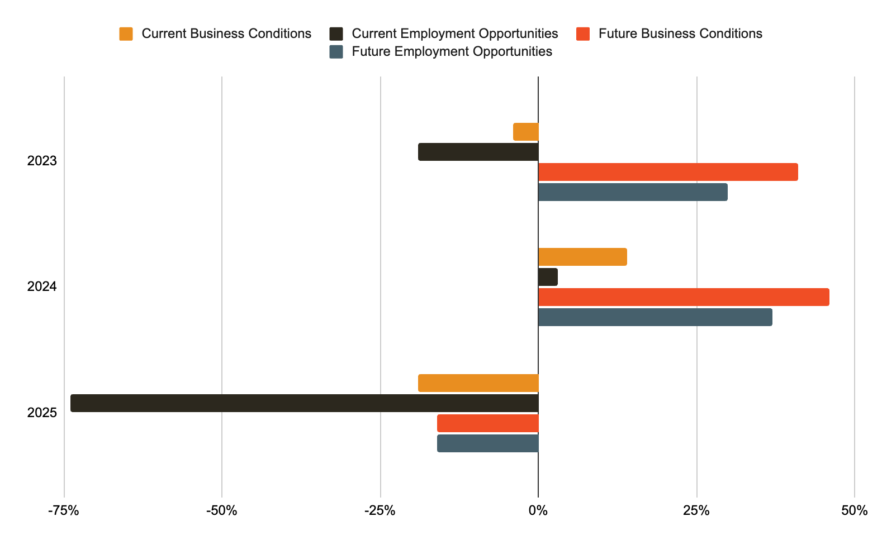
Community Benchmarking Report City of Marquette, KS | 2024
Economic Confidence
Our Economic Perceptions
Year Over Year Change (2023 vs 2024)

Slide 6
Community Benchmarking Report City of Marquette, KS | 2025
Economic Confidence
This year, we’ve noticed people aren’t feeling great about the economy, but they’re still indicating support for local efforts. What factors might be influencing that?

Slide 7
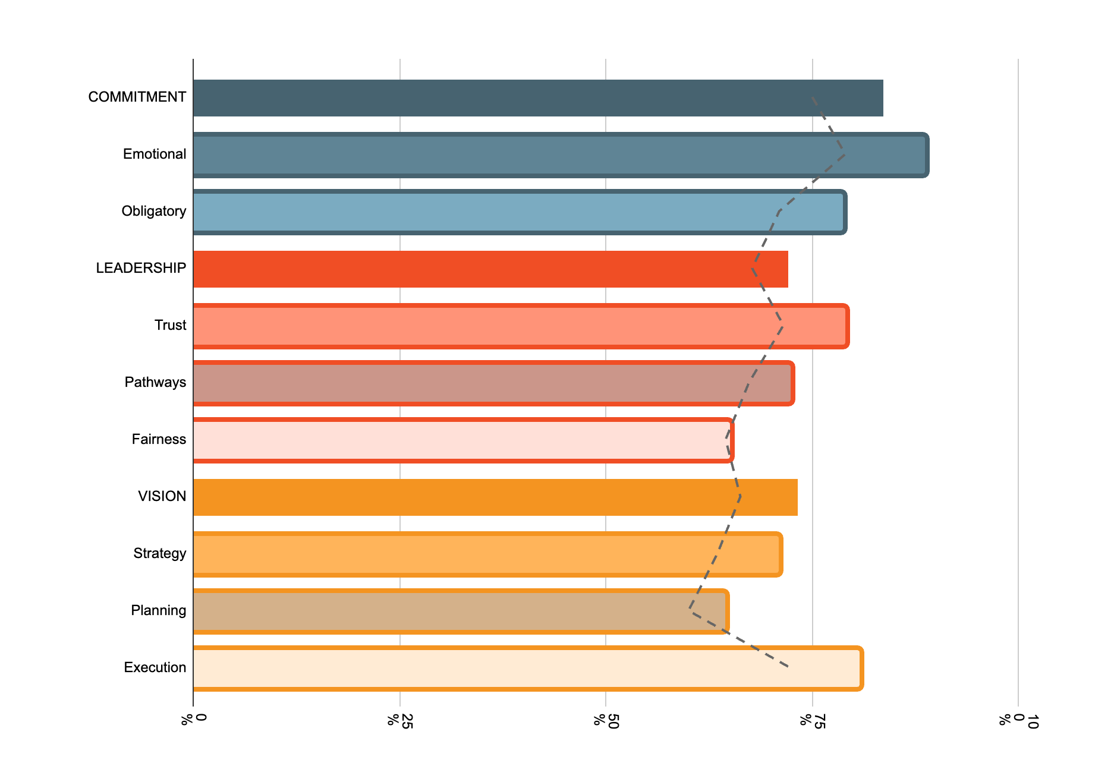
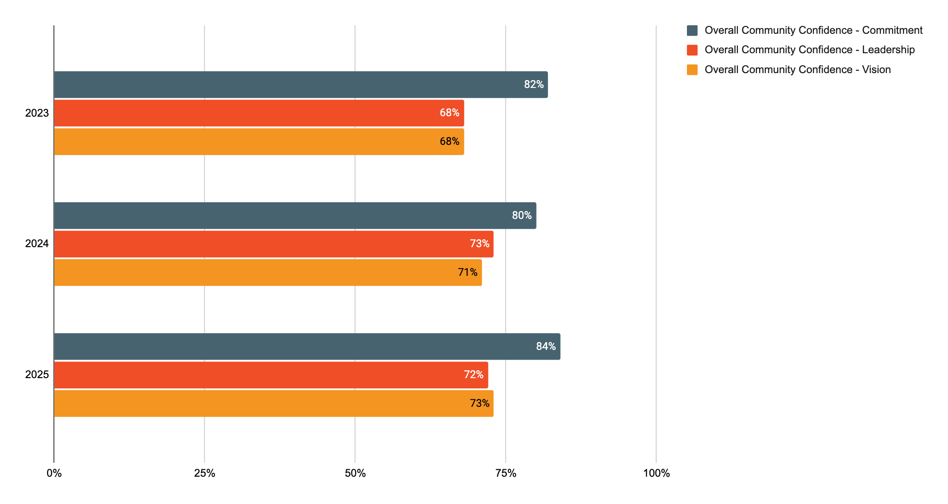
Community Benchmarking Report City of Marquette, KS | 2025
Community Engagement
How do our residents view our community?
Year Over Year Change

Slide 8
Community Benchmarking Report City of Marquette, KS | 2025
Community Engagement
Given the strong sense of belonging in Marquette, how can that shared connection guide or inform our planning work?

Slide 9
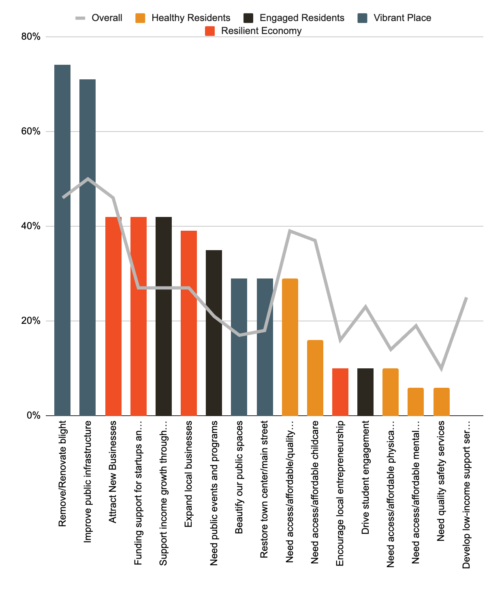
Community Benchmarking Report City of Marquette, KS | 2025
Program Priorities
Community Priorities
Vibrant Place
Resilient Economy
Engaged Citizens

Slide 10
Community Benchmarking Report City of Marquette, KS | 2025
Community Priorities
If you had to choose, where would you put investment energy first?
What is missing from the parks and downtown development?

Slide 11
Community Benchmarking Report City of Marquette, KS | 2025
Moving forward
Flip Neighborhood Development
Opportunities
  Mastermind Grants
  Marquette/ County Grants
  Match Week March 2026

Slide 12


Let’s Continue the Conversation
  Fill Out the Card on your table
  Sign up for Our Newsletter
  Participate in continuing projects
Betsy Davis | betsy@mcphersonfoundation.org

