Slide 1
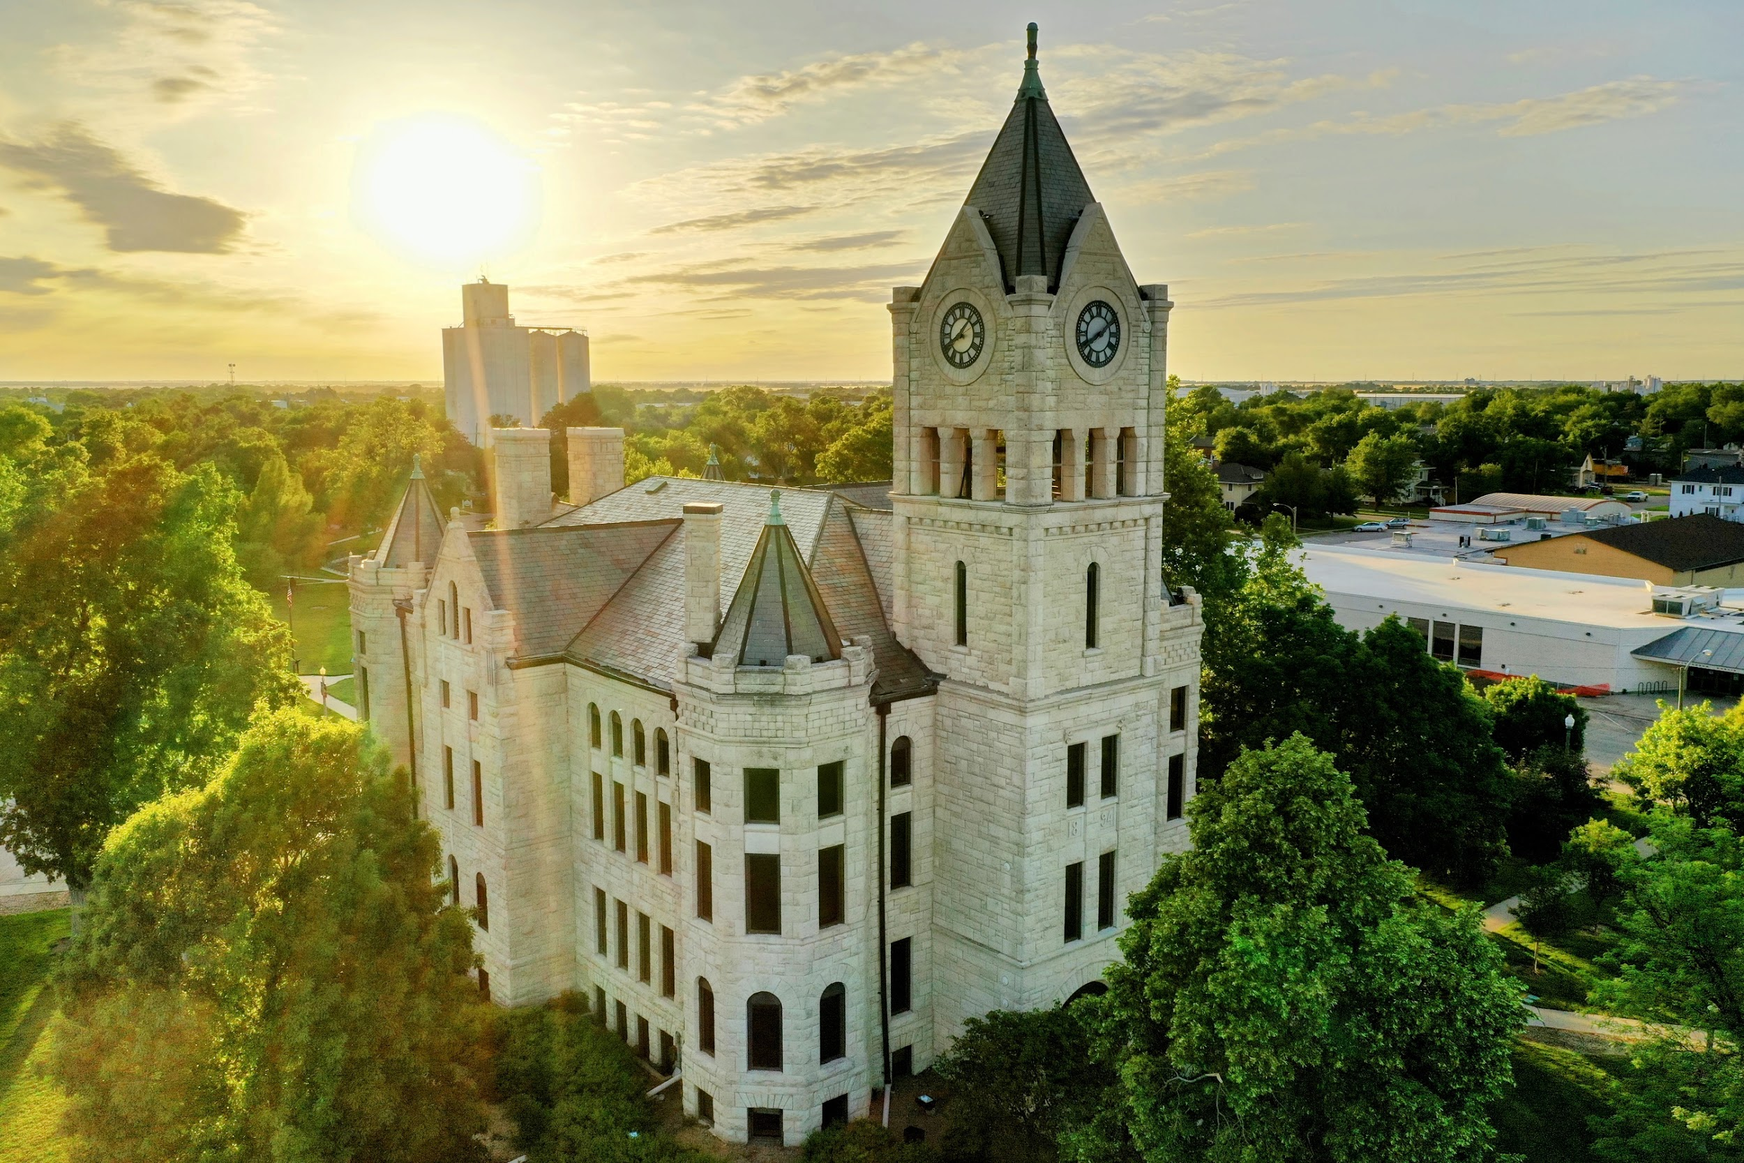





2025
Community Benchmark Report
McPherson County, KS
Be The Movement! Connect with local changemakers, local community projects, resources & grants, and much more. www.mcphersonfoundation.org
Betsy Davis | betsy@mcphersonfoundation.org

Slide 2
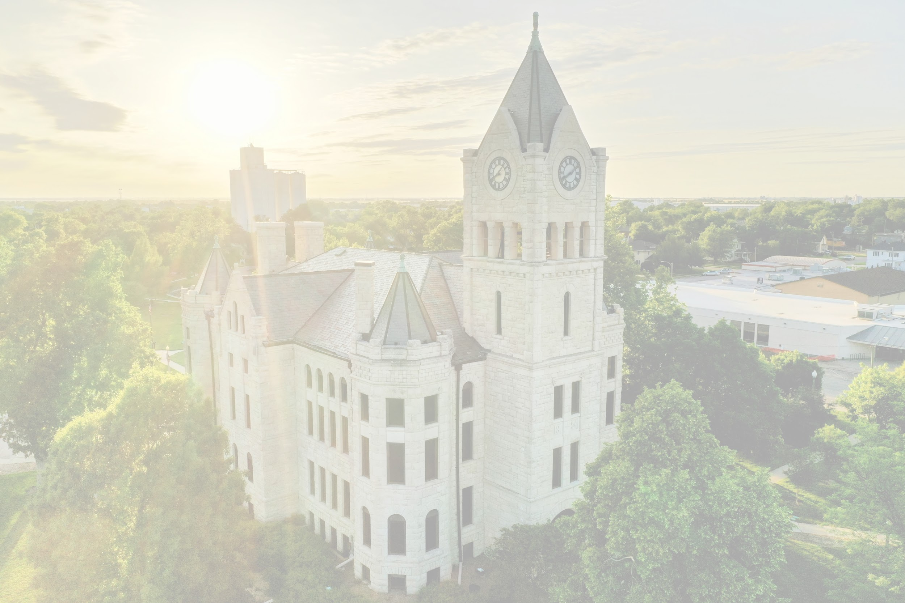



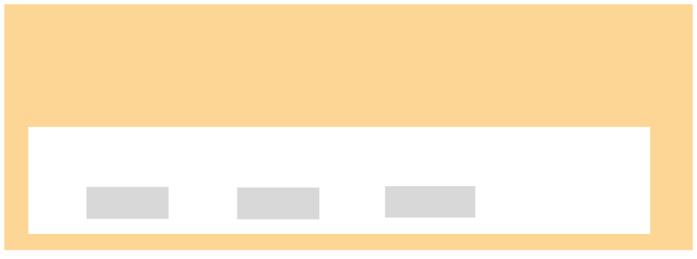




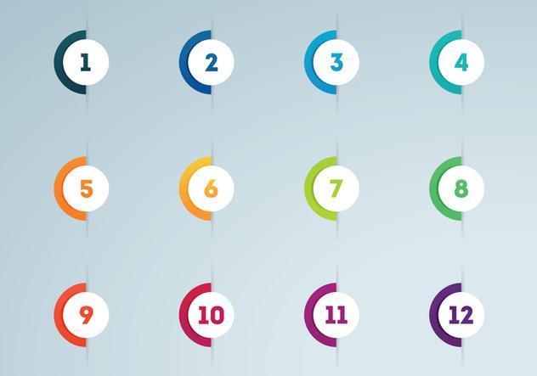



Community Benchmarking Report McPherson County, KS | 2025
The Community Benchmarking report has been commissioned by McPherson County Community Foundation to help local residents gain a better understanding of the most pressing opportunities that the local towns face. The annual reports that are generated will help leaders determine the extent to which the efforts are having an impact on the local residents. The reports are also a way for the the various towns in McPherson County to pursue grants to help further their local efforts.
Local leaders can use this framework to help inspire change.
This report provides the clues on what the fellow residents are craving.
Collaborative Leadership
Committed Citizenship
Community
Economic & Community
Vision & Action
Sustainability

Slide 3
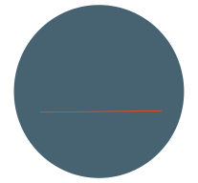

Community Benchmarking Report McPherson County, KS | 2025
Who took the Survey
743
Total Responses
Number of people who expressed an interest in volunteering to better the community
308 of 743 (41%)
308

Slide 4
Community Benchmarking Report McPherson County, KS | 2025
What Makes Our Community Special
Local Leaders

Slide 5
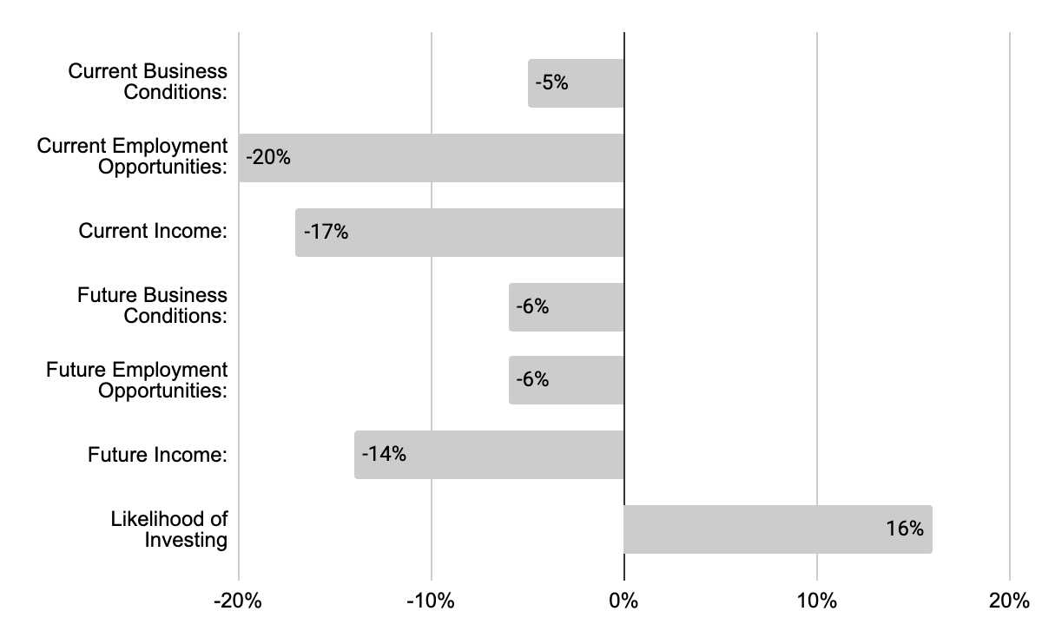
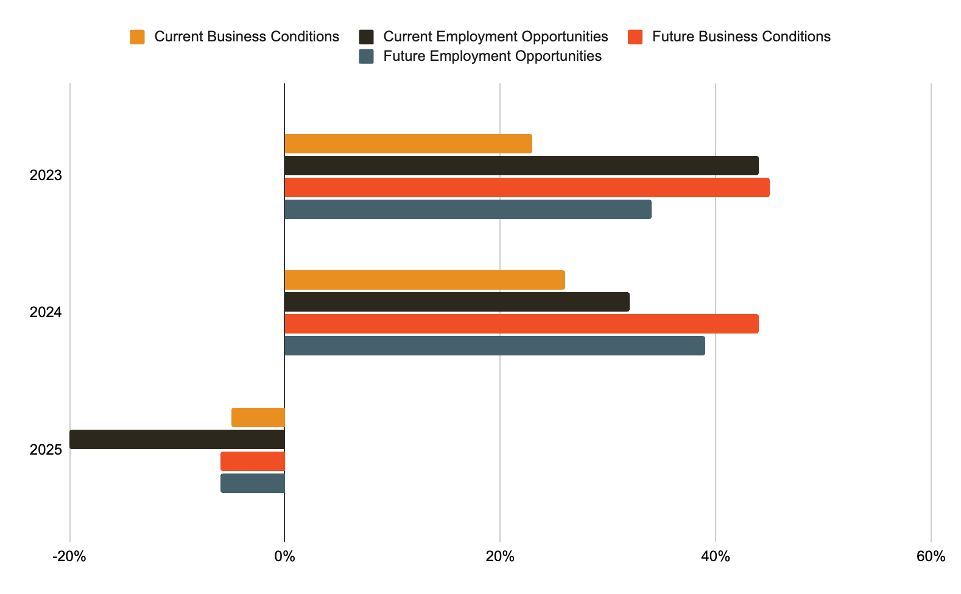
Community Benchmarking Report McPherson County, KS | 2025
Economic Confidence
Our Economic Perceptions
Year Over Year Change (2023 vs 2025)

Slide 6
Community Benchmarking Report McPherson County, KS | 2025
Economic Confidence
Employment opportunities took a large hit from last year. What could be done to address this negative perception shift?

Slide 7
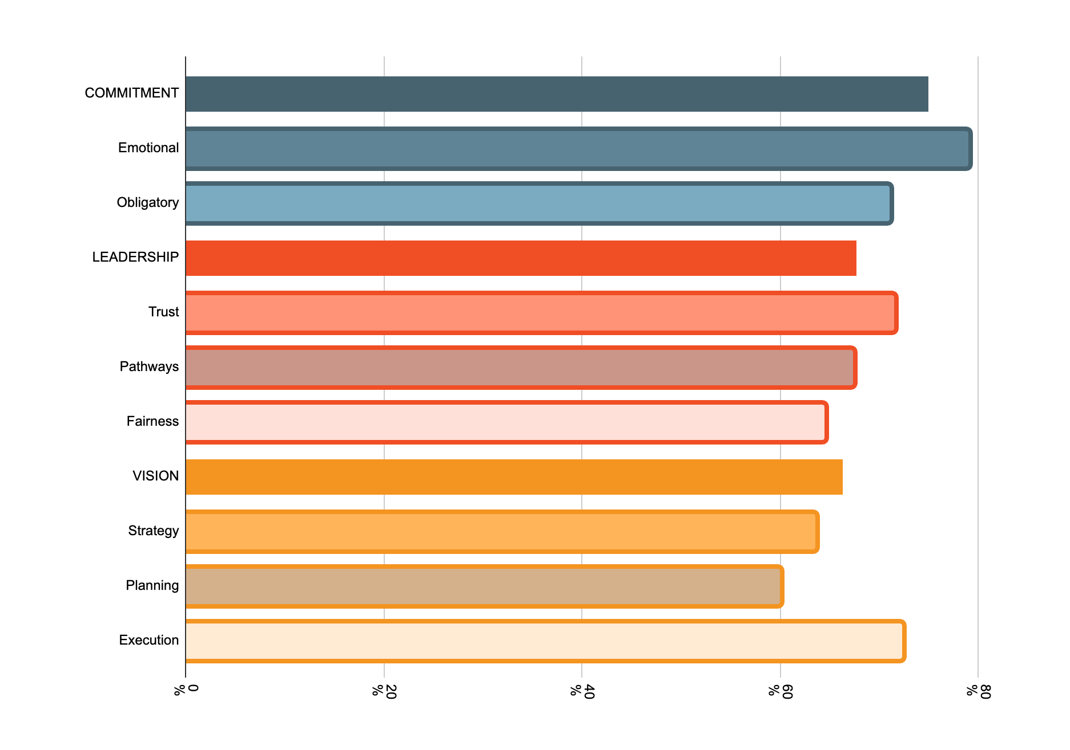
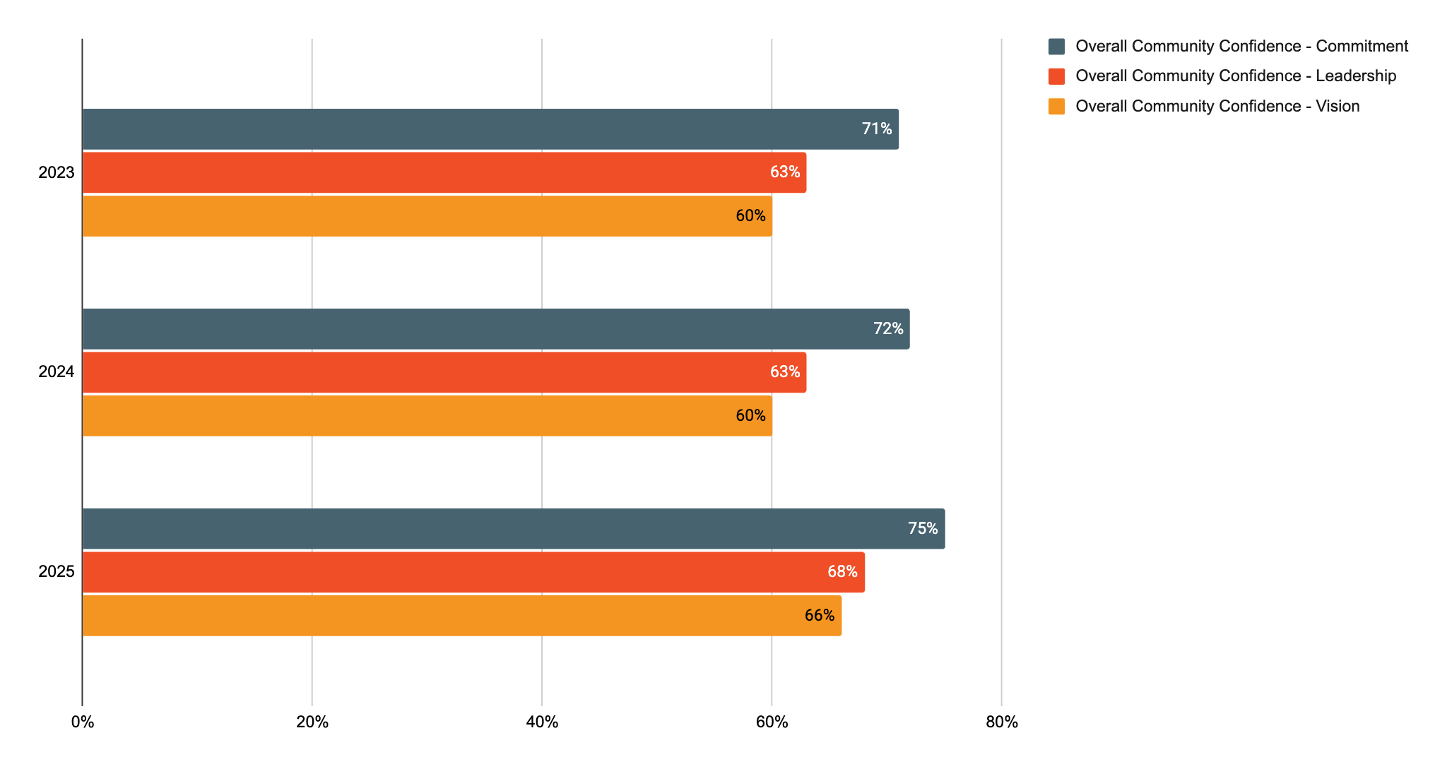
Community Benchmarking Report McPherson County, KS | 2025
Community Engagement
How do our residents view our community?
Year Over Year Change

Slide 8
Community Benchmarking Report McPherson County, KS | 2025
Community Engagement
Planning and articulation of plans got better across the county. How can we expand that to include more folks?

Slide 9
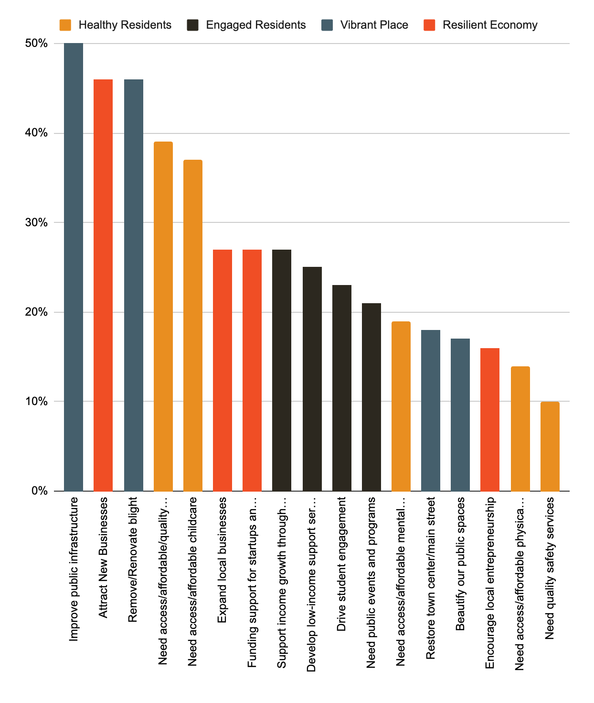
Community Benchmarking Report McPherson County, KS | 2025
Community Priorities
Program Priorities
Vibrant Place
Resilient Economy
Healthy Residents

Slide 10
Community Benchmarking Report McPherson County, KS | 2025
Community Breakouts
If you had to choose, where would you put our investment energy first?
If you could only invest $15,000 annually over the net three years, how would you invest in your community?

Slide 11
Community Benchmarking Report McPherson County, KS | 2025
10 Minute Break
We will be breaking up into interest groups after we return
Parks
Third Space
Neighboring
Downtown

Slide 12
Community Benchmarking Report McPherson County, KS | 2025
Breakout work groups
Current State
Desired state
Takeaways/ next steps

Slide 13
Community Benchmarking Report McPherson County, KS | 2025
Moving forward
Opportunities
Mastermind Grant
County Grants
Match Weeks
Galva September 2025
Inman October 2025
Moundridge November 2025
County Wide March 2026

Slide 14


Let’s Continue the Conversation
Fill Out the Card on your table
Sign up for Our Newsletter
Participate in continuing projects
Betsy Davis | betsy@mcphersonfoundation.org

